Slide 1
Barrier detectives
2021st
Montenegro, bosnia and Herzegovina & germany

Slide 2
content
Public Institutions
Sport and fun
Public transportation
Kids’ Playground
Libraries
MAIN FOCUS: Detecting barriers which people with disabilities are facing and trying to fix it

Slide 3
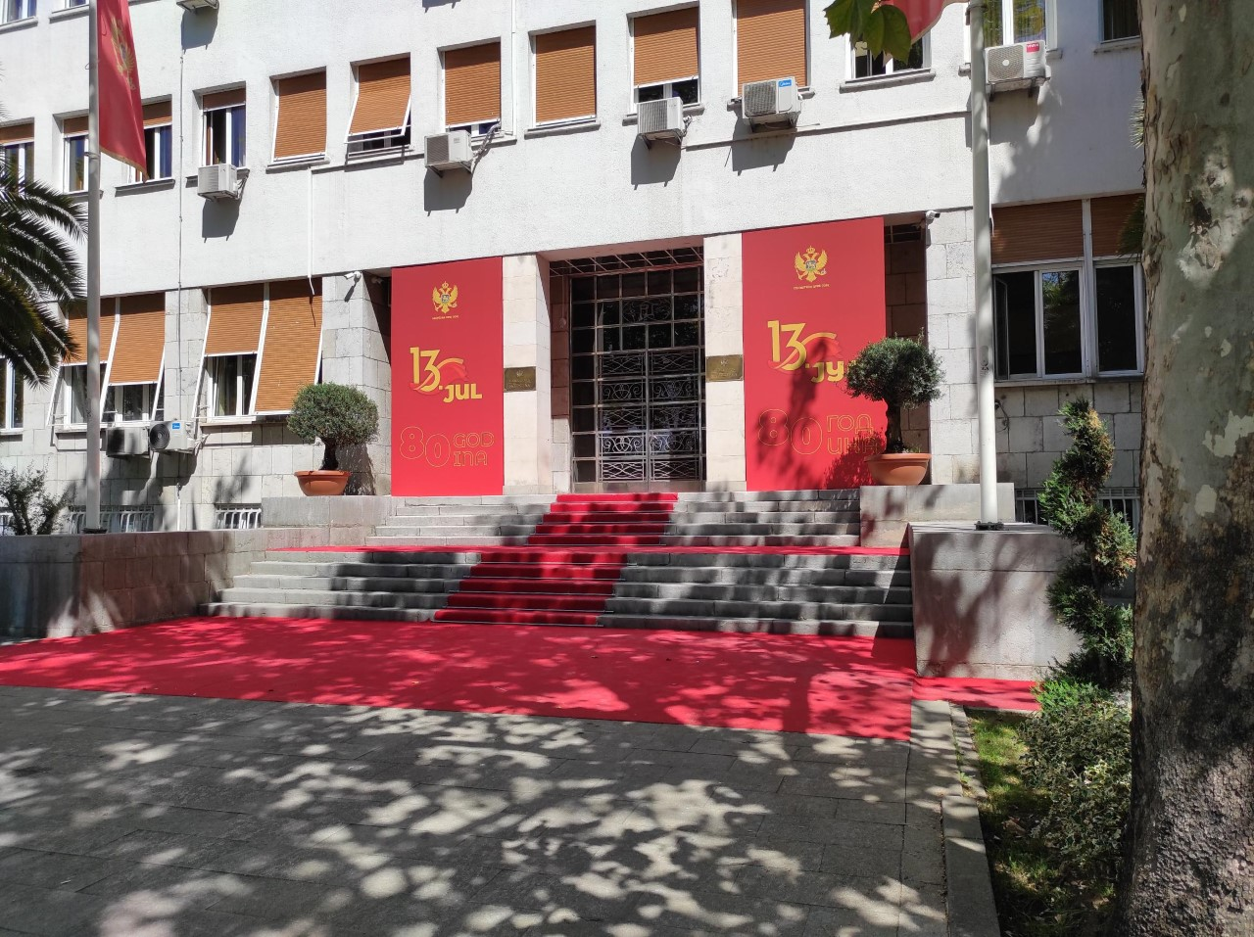
Public institutions – parliament of montenegro
The ramp doesn’t exist
The elevator doesn’t exist
There’s one more building, but this is the capital one
Planning to build new accessible place as soon as possible
It’s forbidden to take indoor pictures

Slide 4
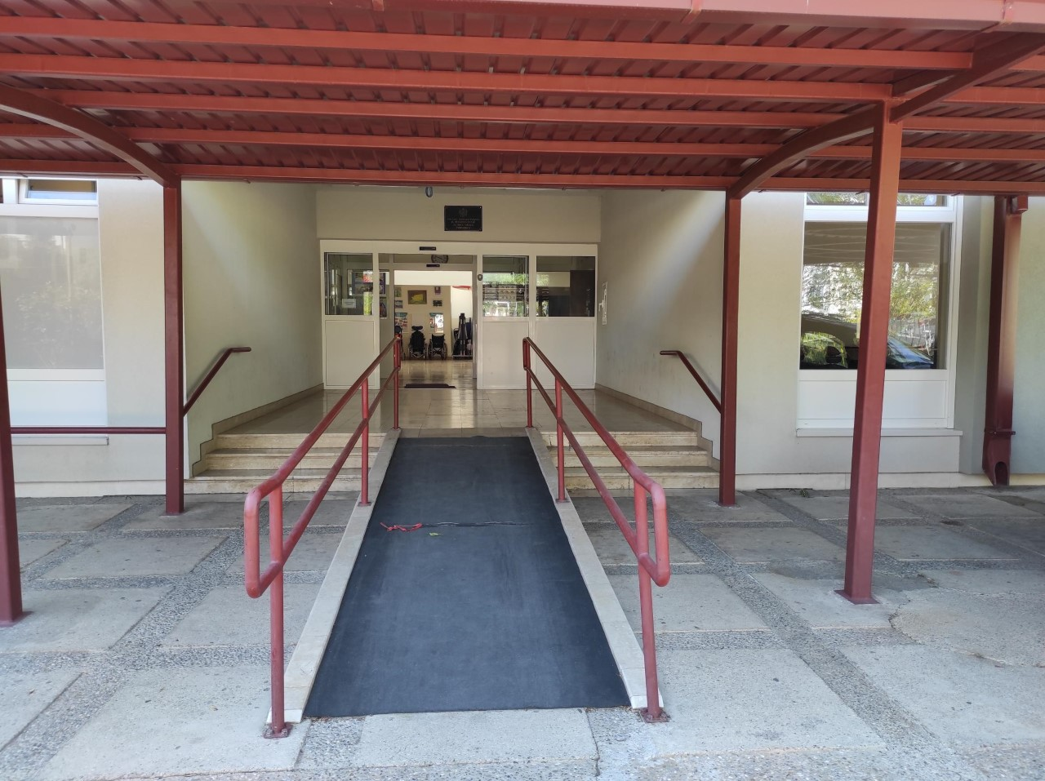
Public institutions – resursni centar ,,1. jun’’
High accessibility of the place; ramp, elevator, Braille letter, audio format
Personnel deeply understand UN Convention
Everyone is specialized to work with OSI group, since it’s their main focus

Slide 5
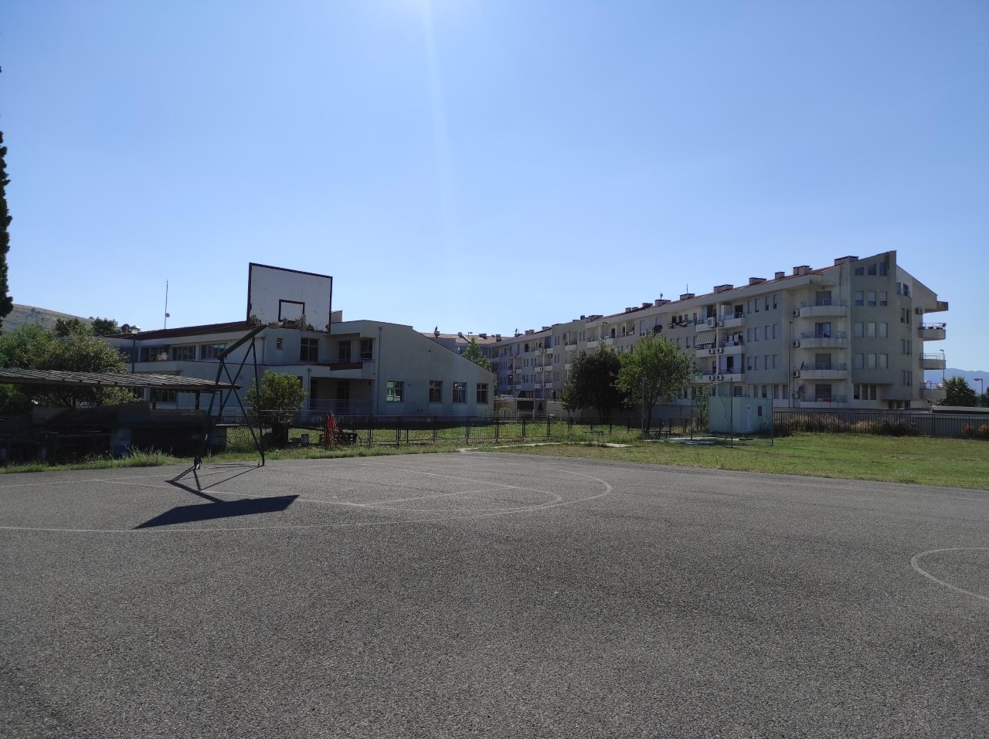
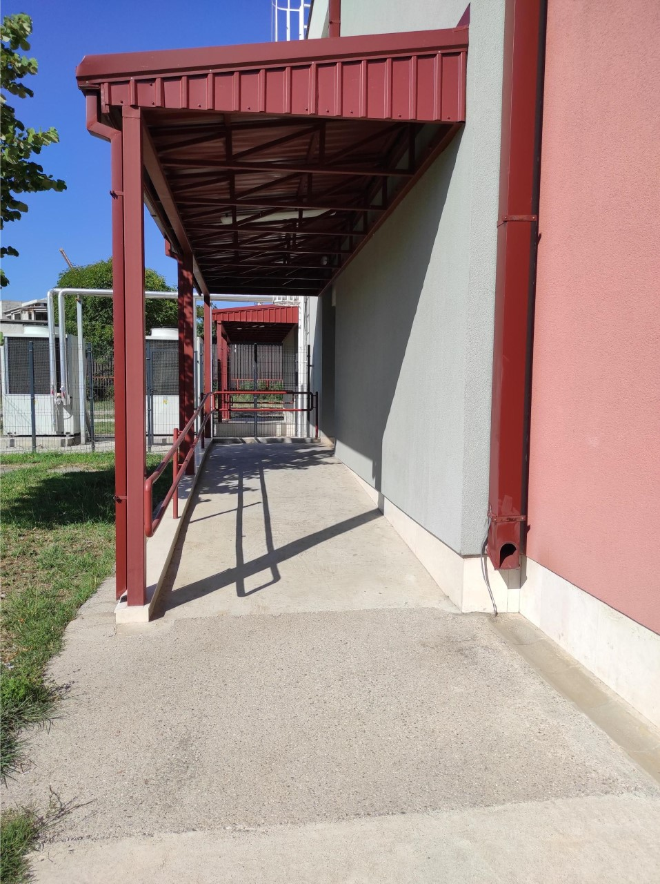
Playground and ramp on the other side of the ,,1st June’’
There’s a special team who helps OSI during they everyday activities in this school including training, playing sports like basket

Slide 6
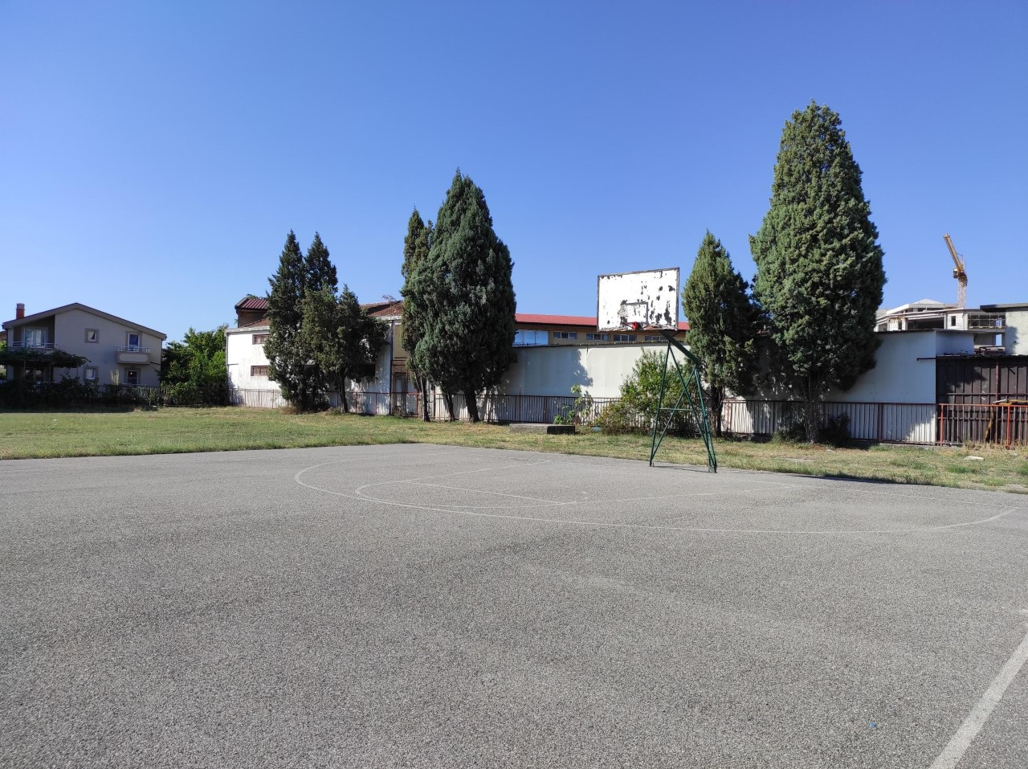
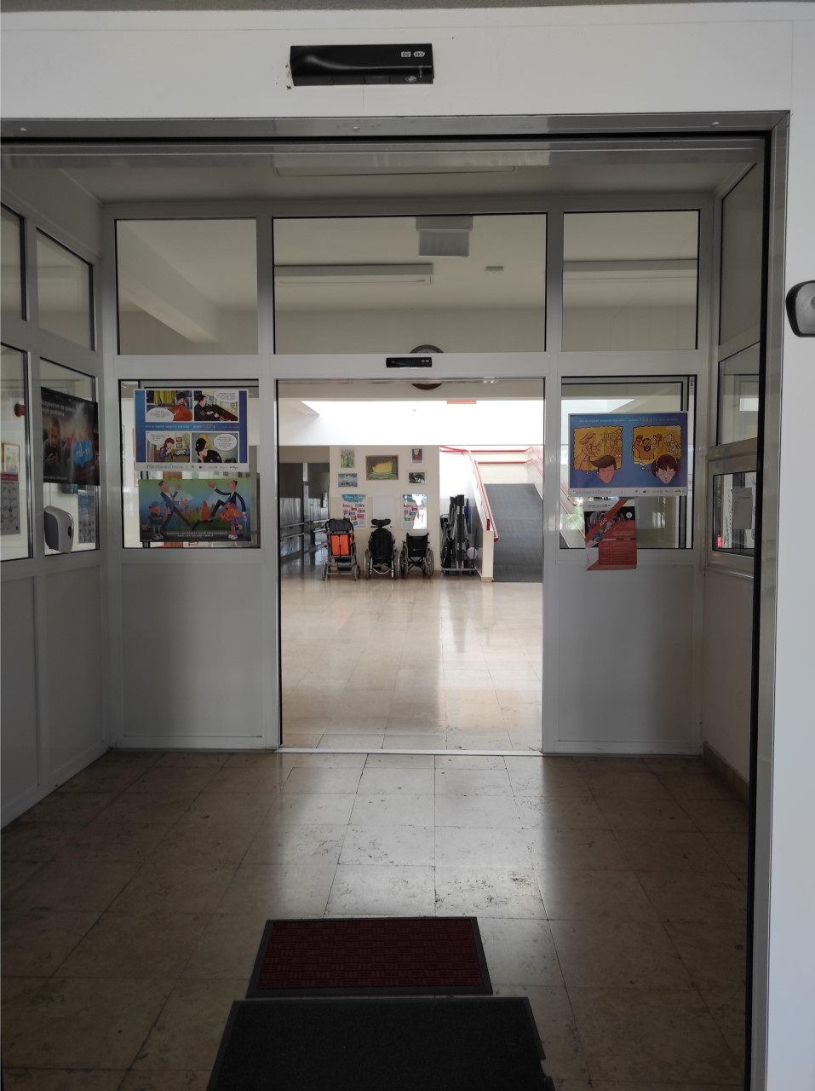
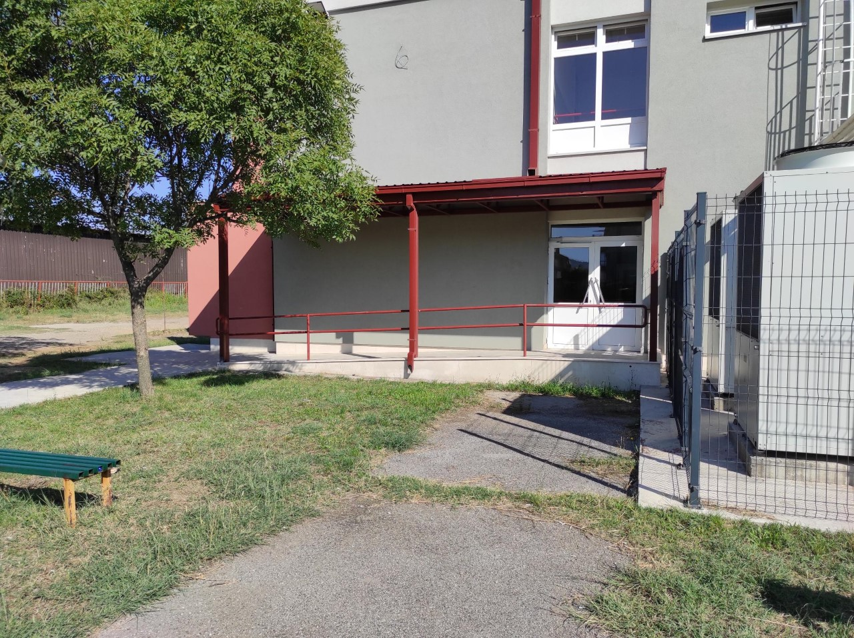
,,1st June’’ has additional wheelchairs for those who want to have education here, but don’t have their own wheelchairs. Unfortunately, sometimes it happens.

Slide 7
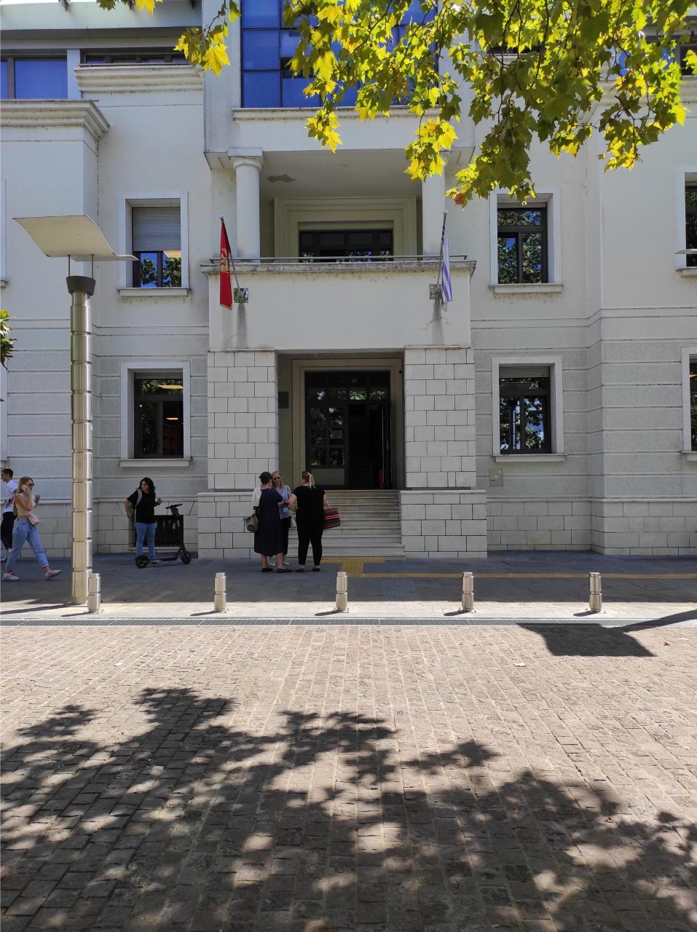
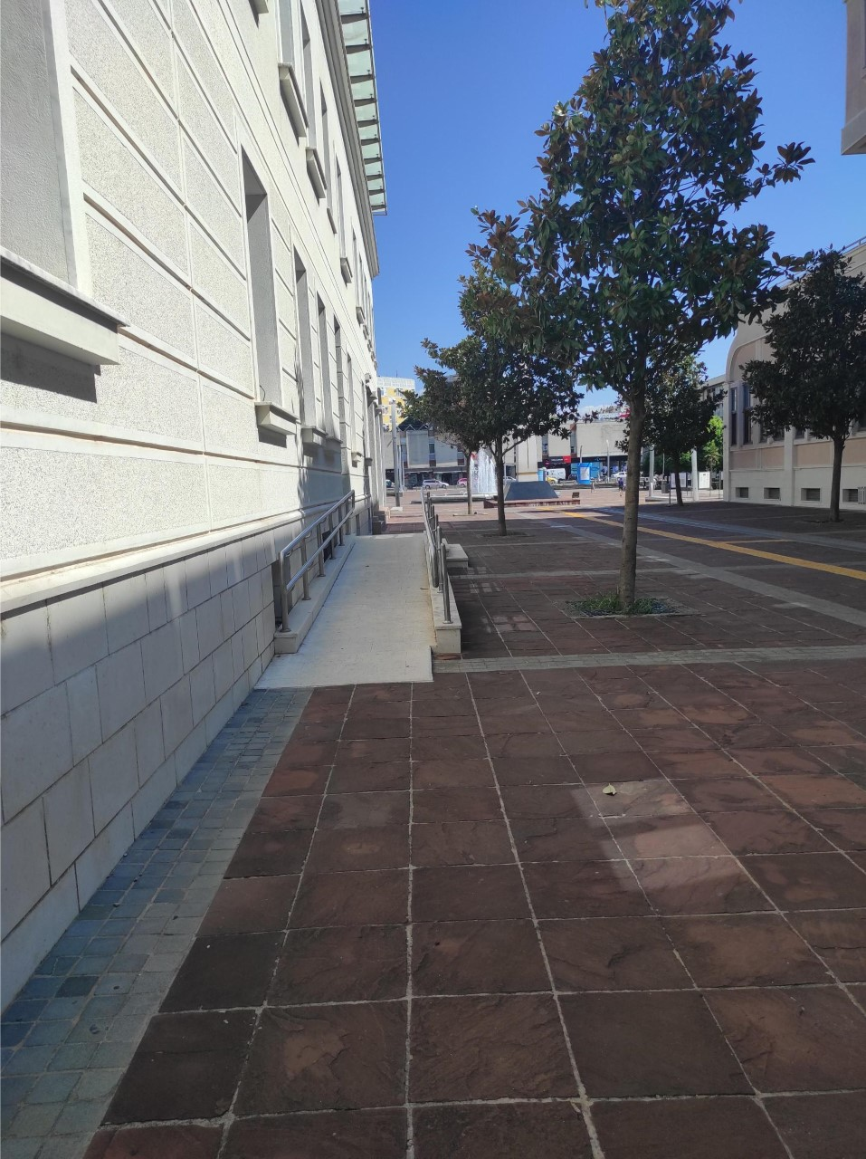
Public institutions – libraries
,,radosav Ljumović’’
One of the biggest national labraries in Montenegro ,,Radosav Ljumović’’ is placed in the heart of Podgorica. The institution is accessible than many more of them in the capital city.
It is divided into two enterances. In the first photo we can see first one, obviously inaccessible, and in a second photo we can see the enterance which is made for persons with disabilities.

Slide 8
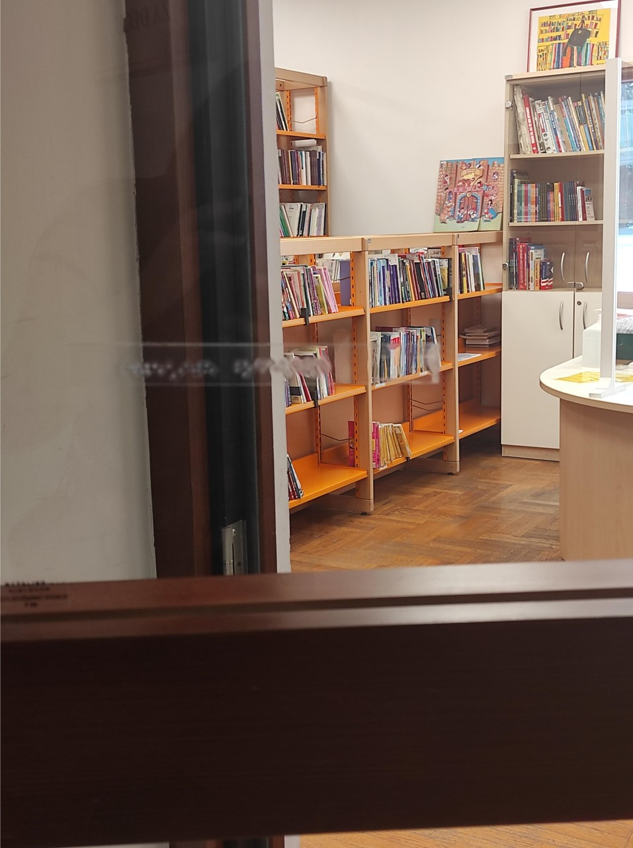
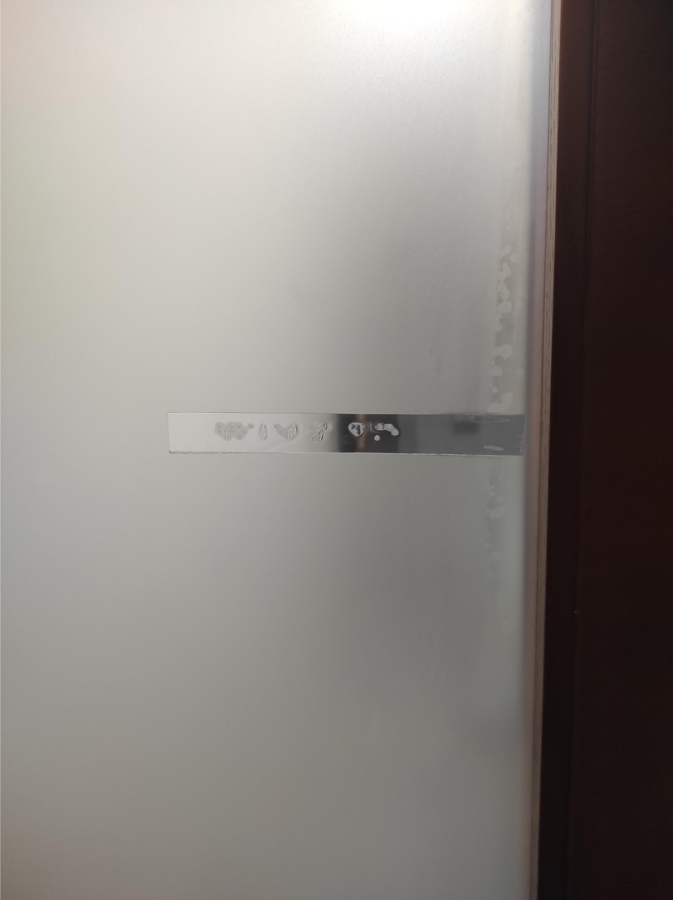
Basically every important place is marked with Braille letter.

Slide 9
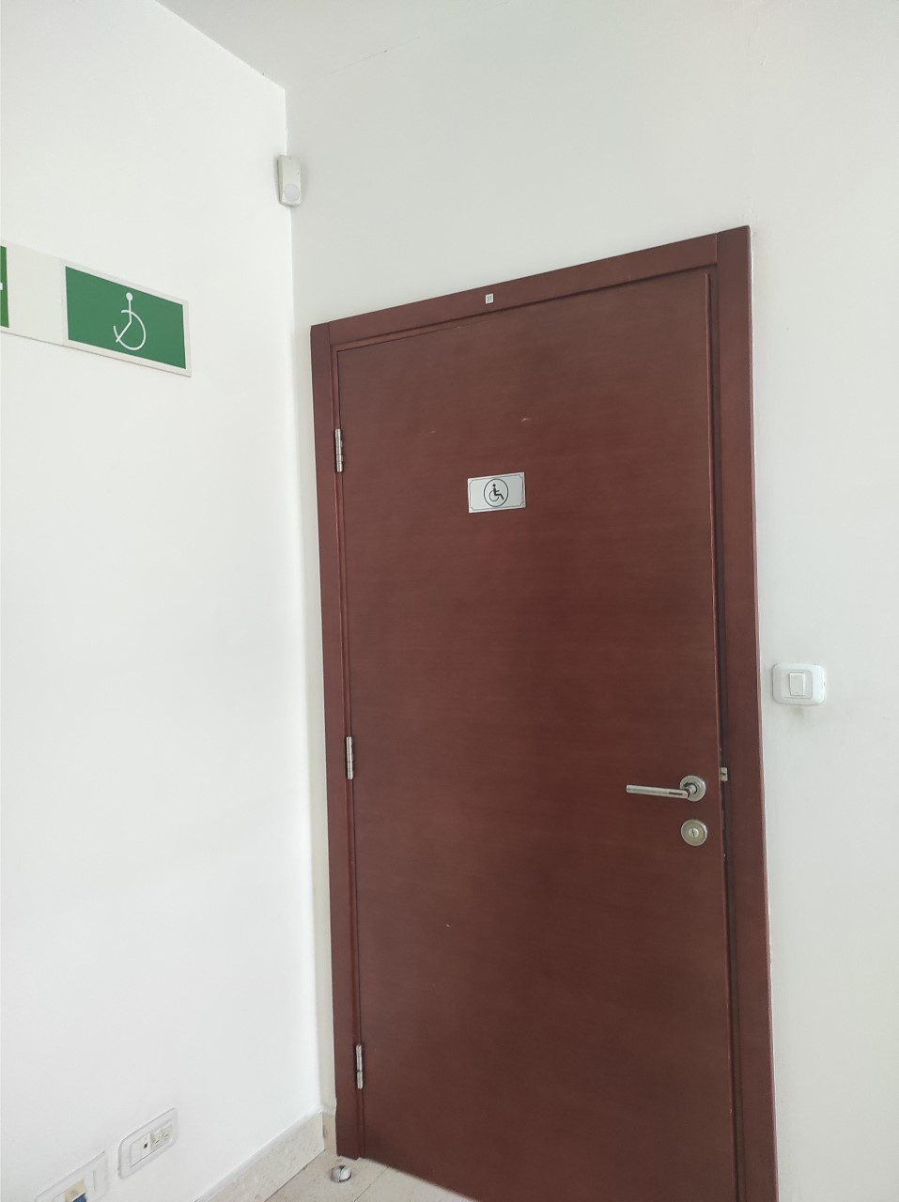
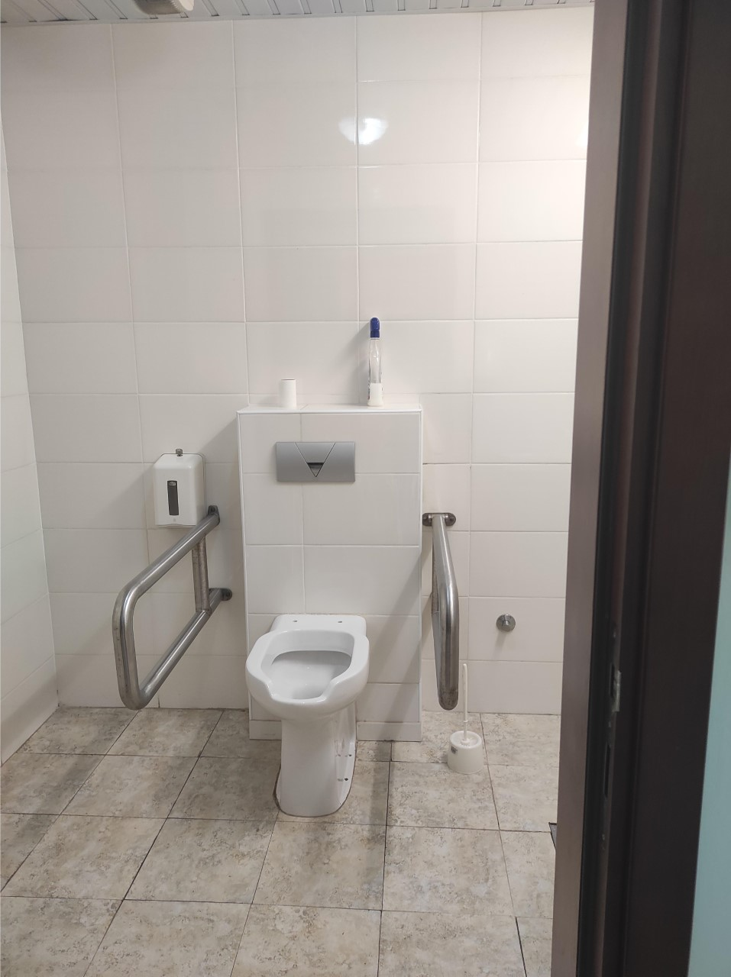
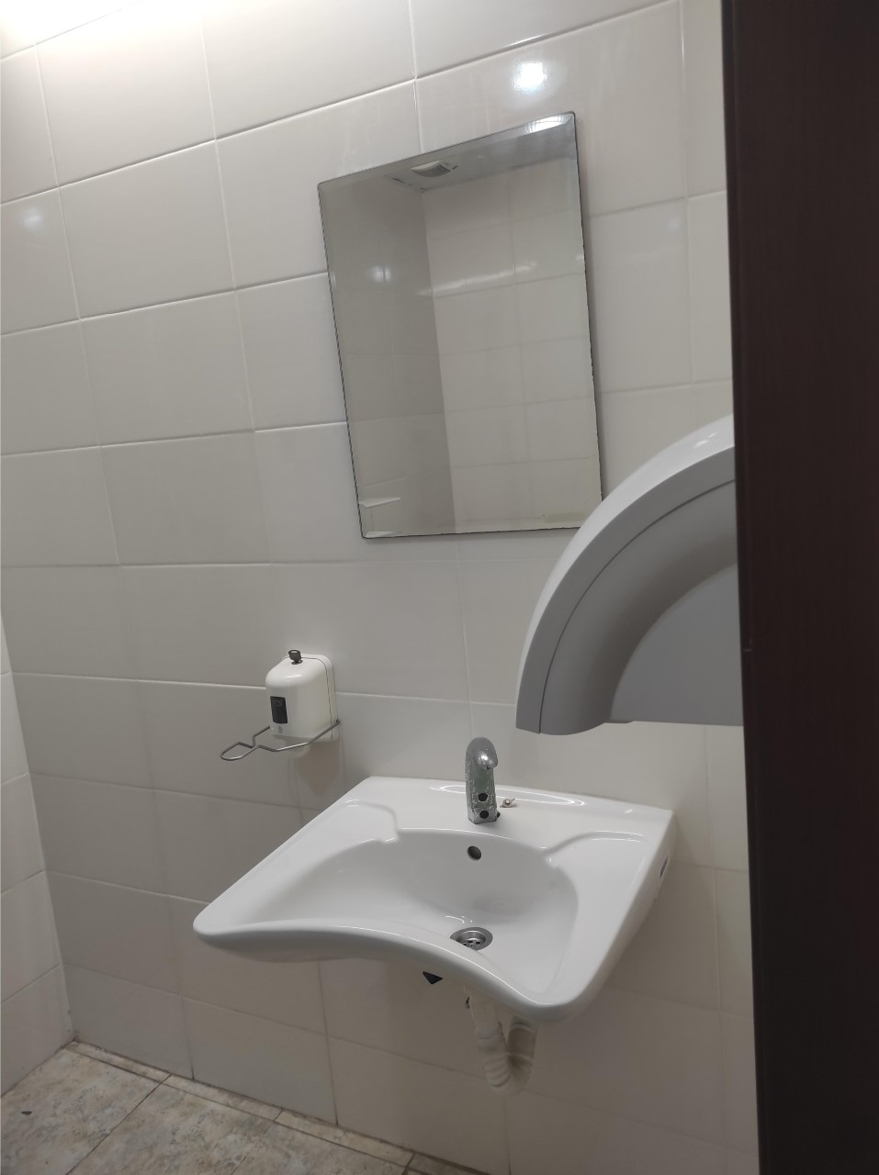
Toilet for people with disabilities in the national library ’’Radosav Ljumović’’

Slide 10
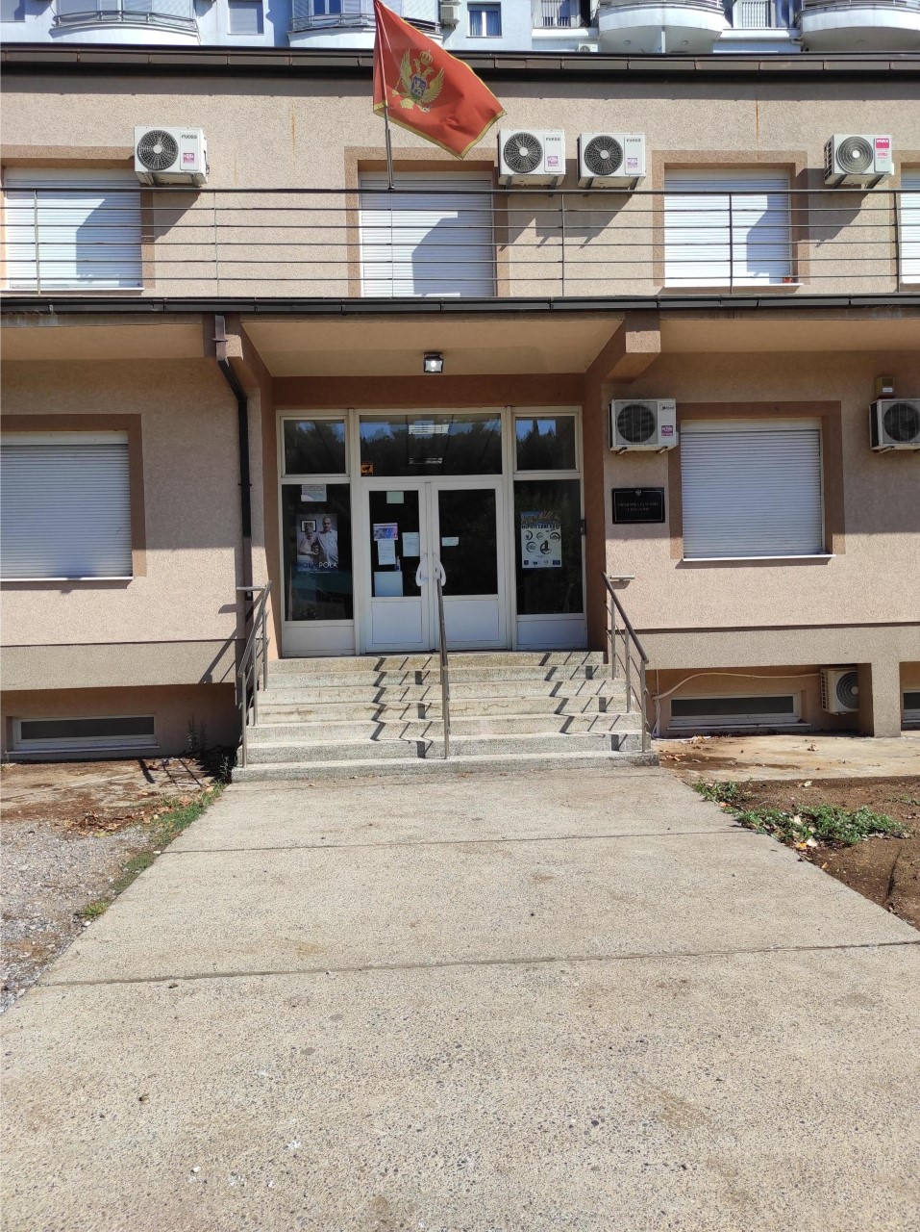
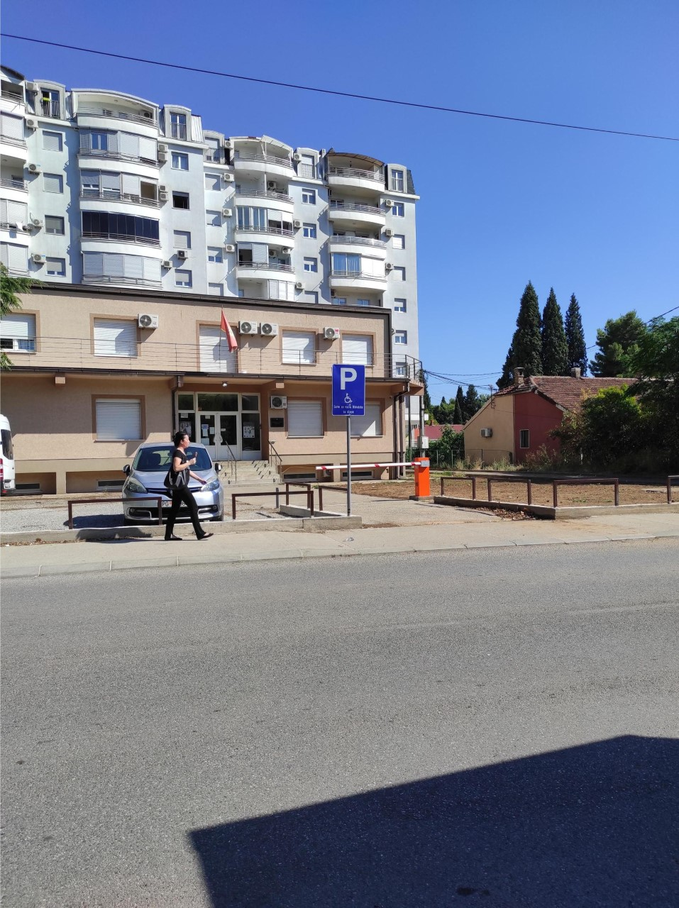
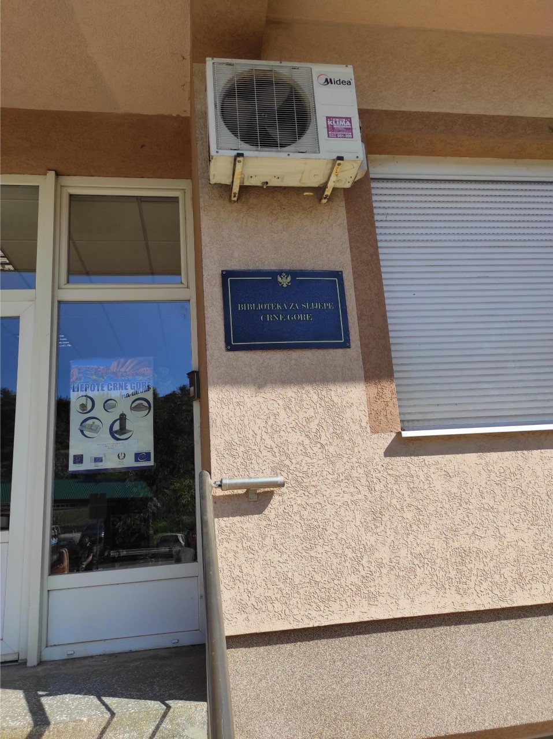
National library for blind people of montenegro
One of the most interesting institutions that we’ve visit is Public library for blind people.
Likewise, everyone who wants to borrow an audio book can do it in that places, even people without any disability.
There’s no ramp, but they have system for people in the wheelchairs. Anyone can ask for the book by e-mail or a phone-call and they’ll send it on the mail adress, even in outside the Montenegro.

Slide 11
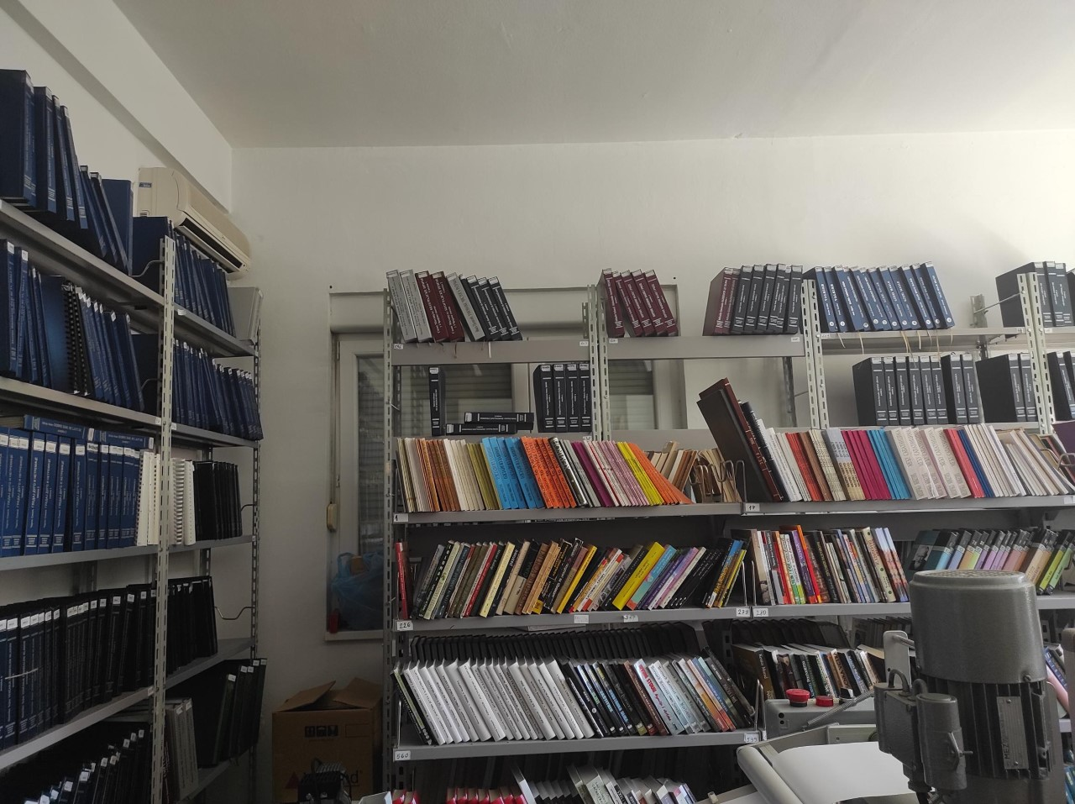
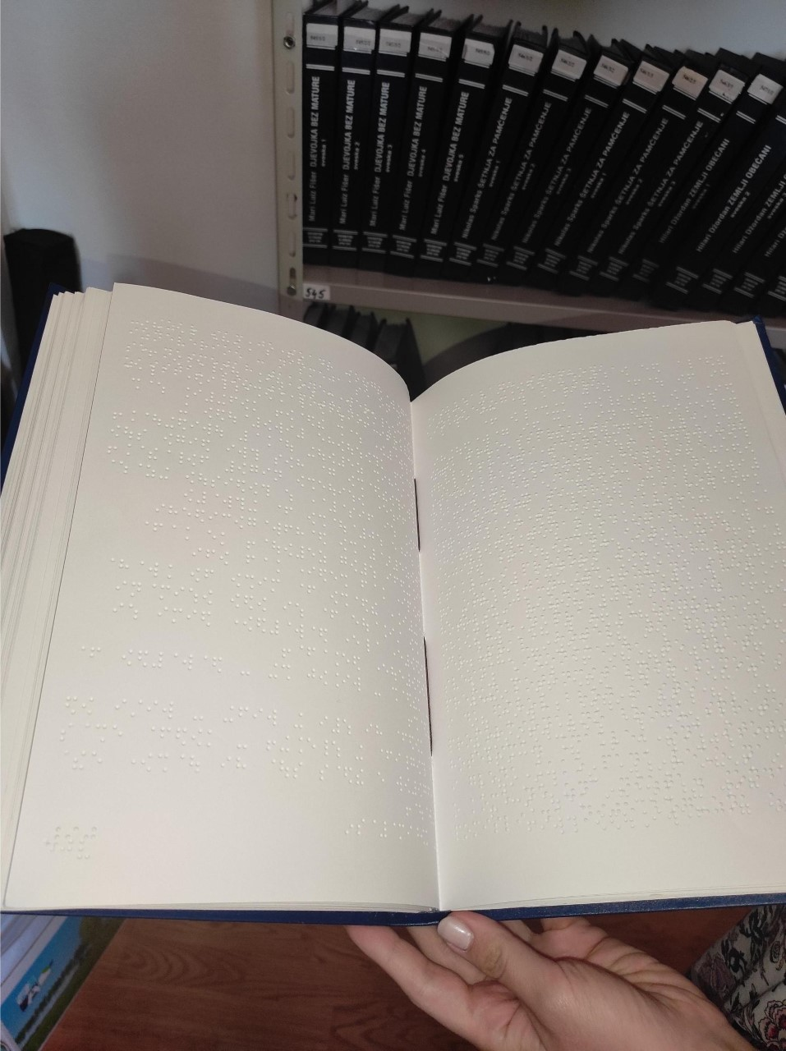
A lot of books are available in audio format, and a little bit less of them are pressed in the Braill letter

Slide 12
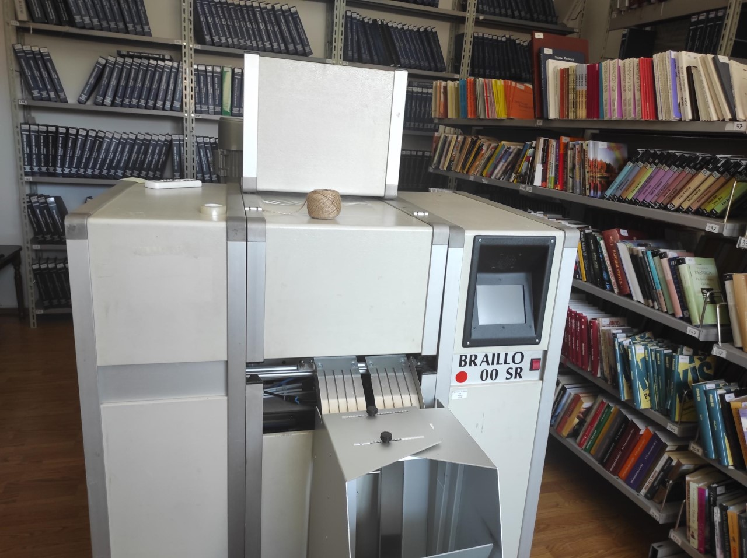
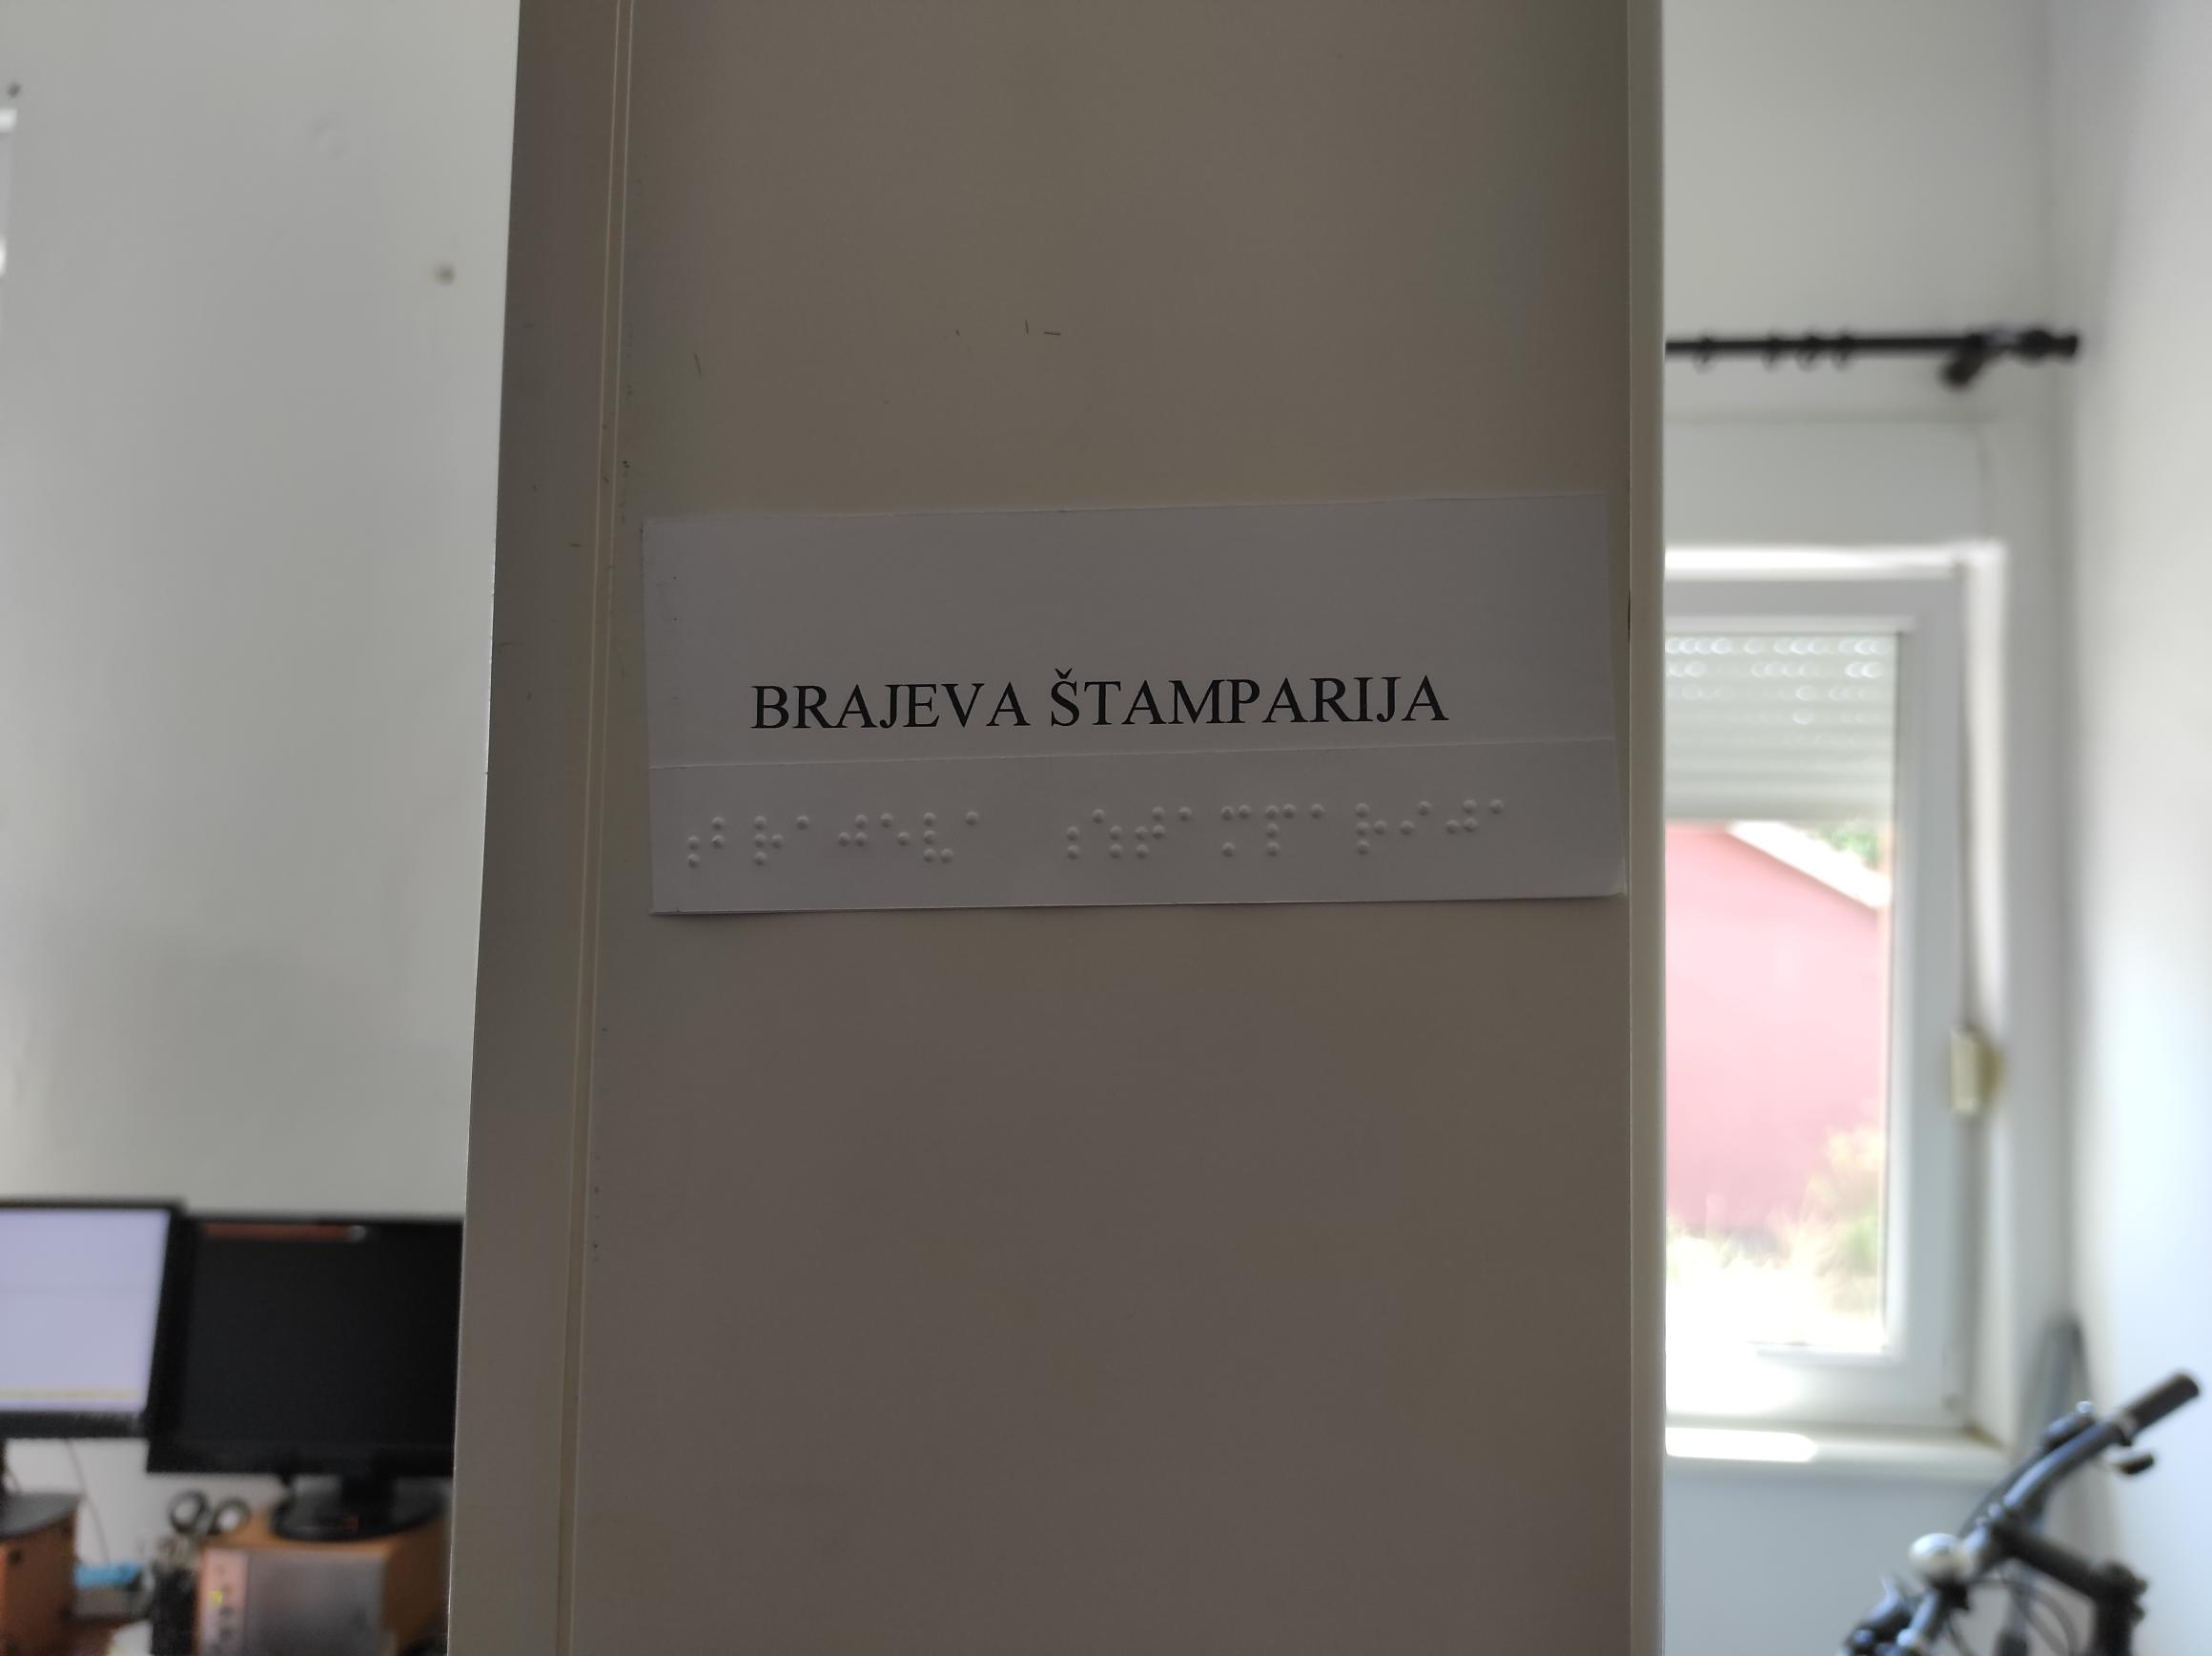
Braille’s pressroom

Slide 13
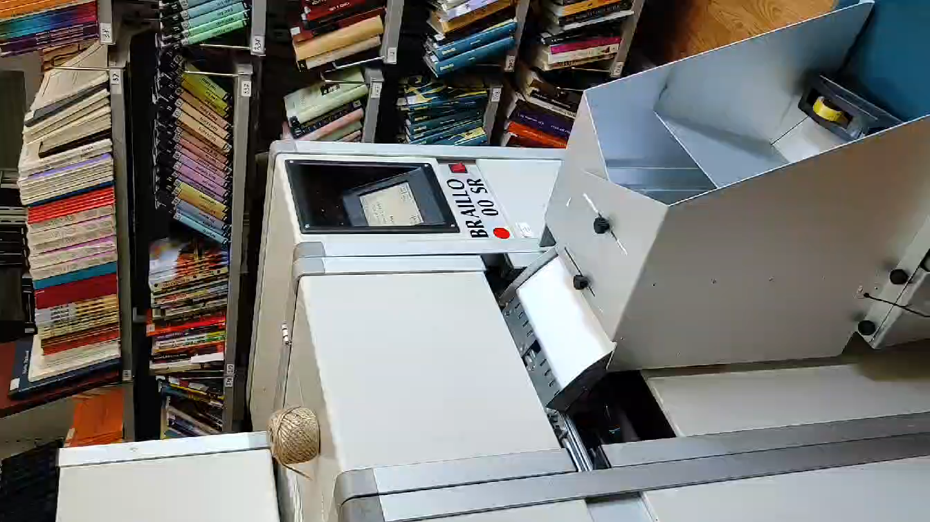
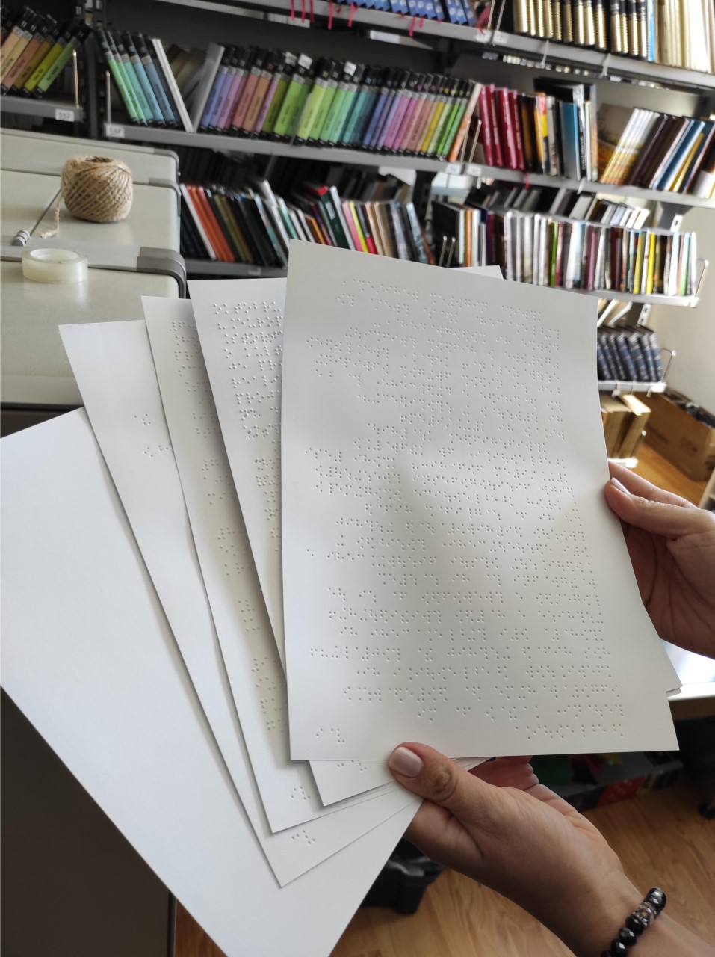
They showed us the process of pressing the article in Braille’s letter.

Slide 14
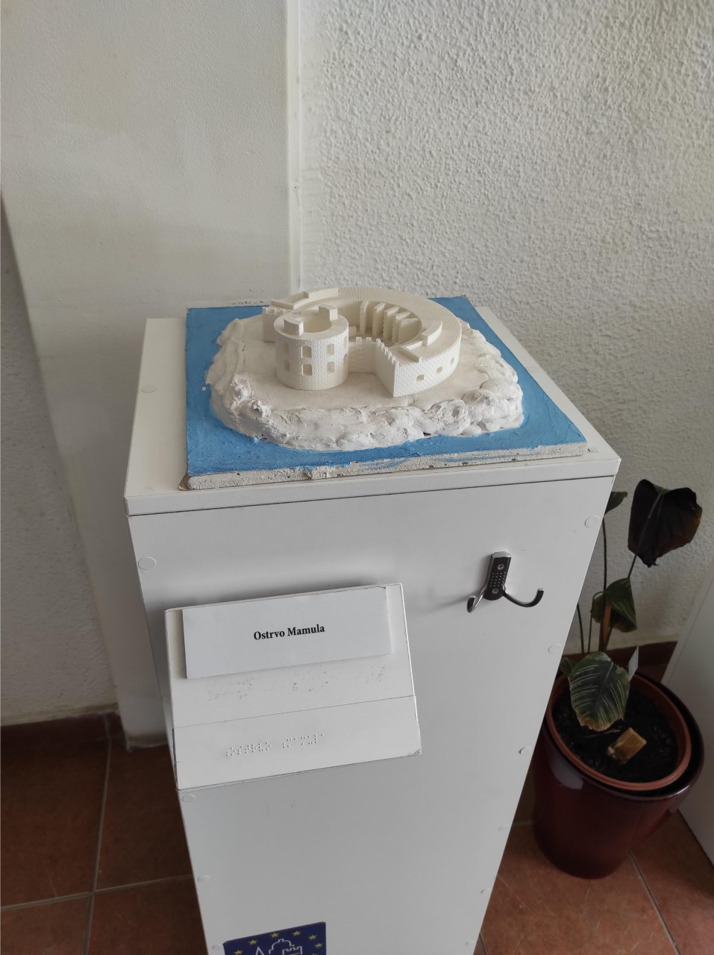
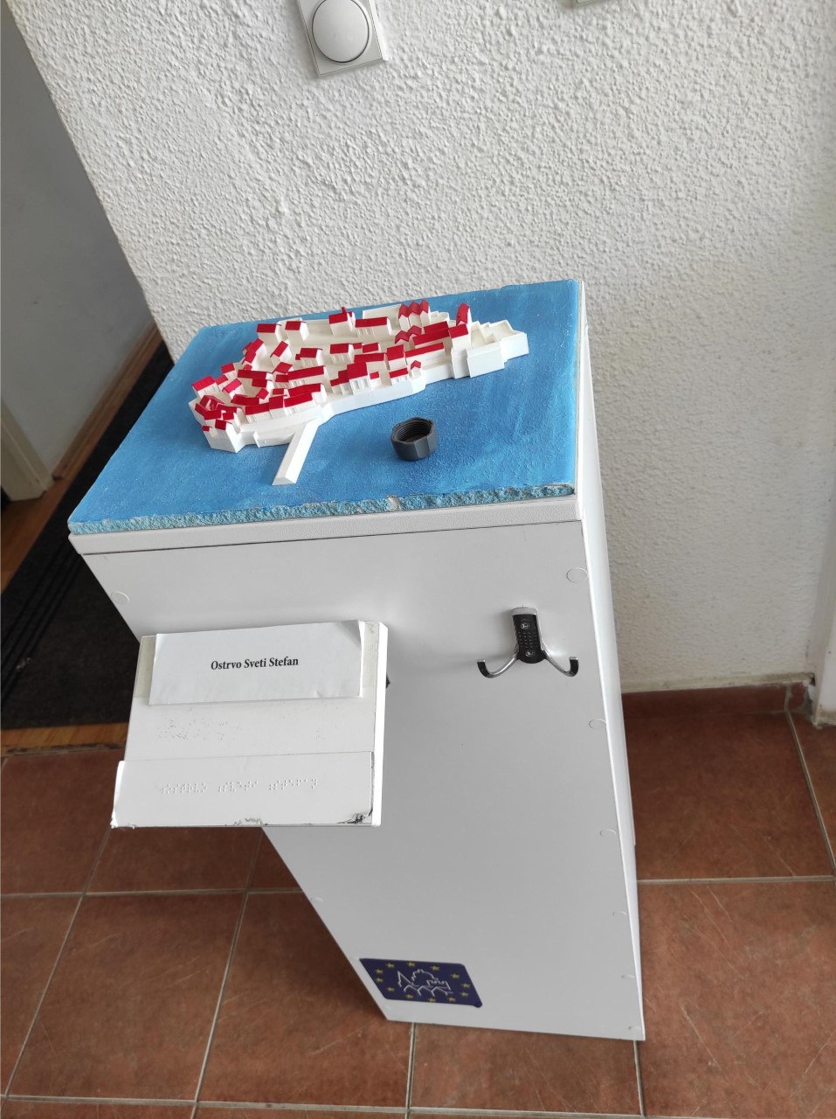
Here, they created models (mock ups) of the most attractive tourist places in Montenegro, such as Mamula Island and Saint Stefan.
Blind people can use it as a map, or simply the way to feel the place.
For those who are interested to learn more about these mock ups, there’s a book by Anthony Door ,,All the lightness we cannot see’’.

Slide 15
Schools – ju mješovita srednja škola golubovci
The youngest High school in Montenegro
Very accessabile
The most modern school in Montenegro

Slide 16
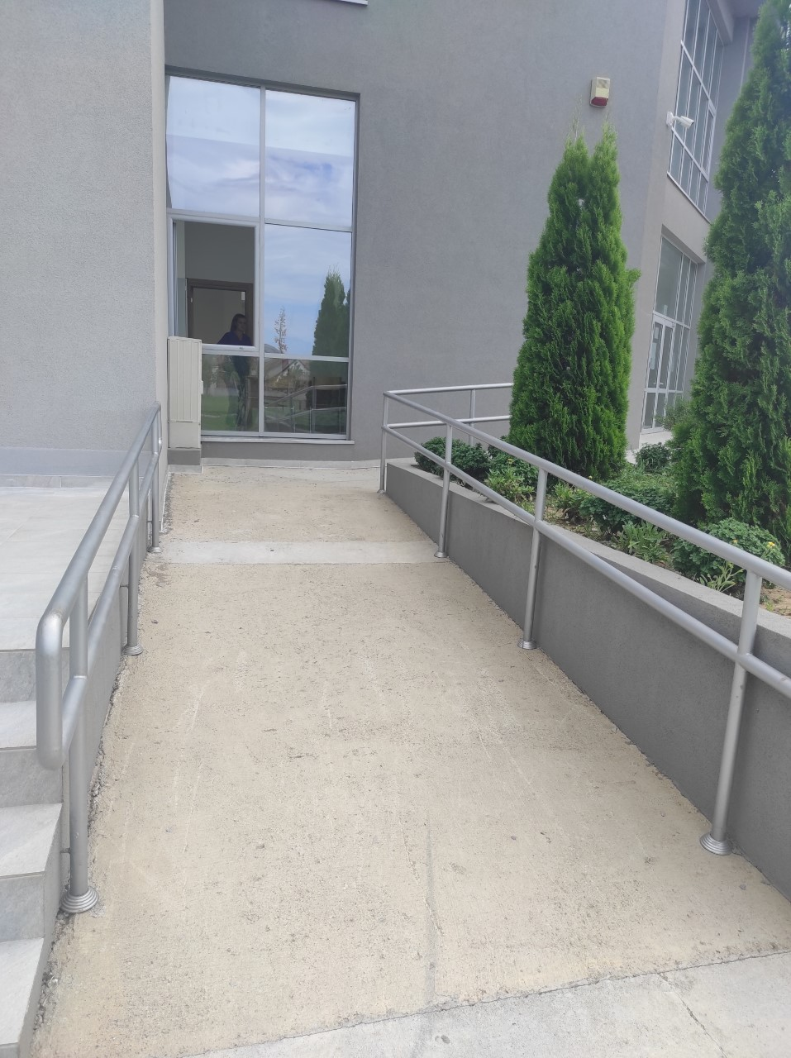
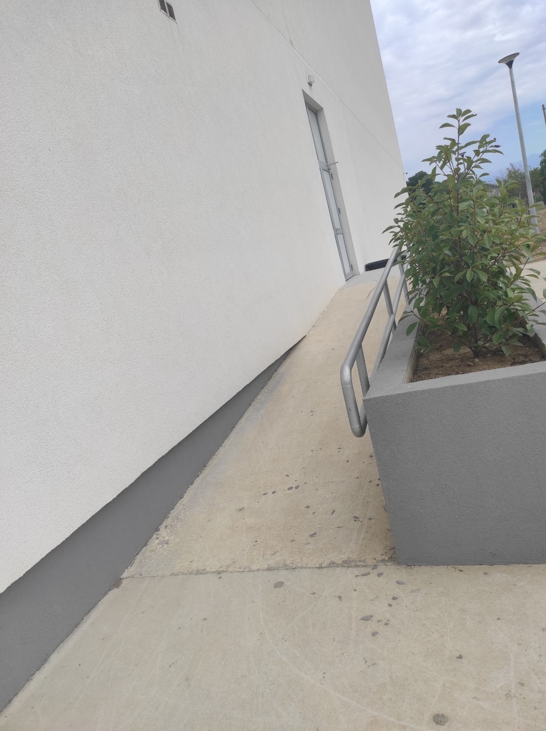

Slide 17
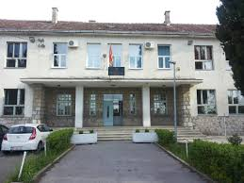
SCHOOLS – OŠ ,,MiLAN VUKOTIĆ’’
This place is very inaccessiable, the school does not have a ramp, elevetor or any of elementary needs for people with disabilities, but they do have pwd enrolled in this school.
The personnel of school is nice and they understand obstacles which pwd are facing. There is a specialized person who take care about OSI group.

Slide 18
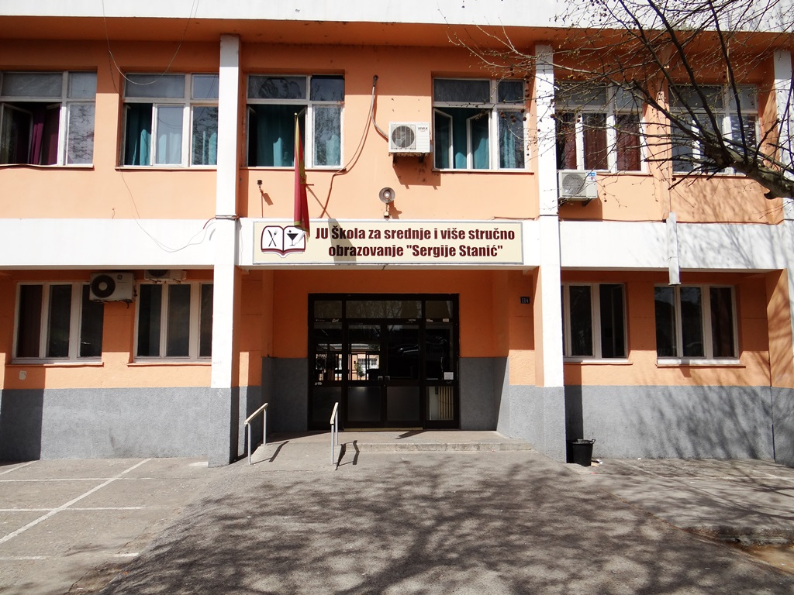
Schools – svsš ,,sergije stanić’’
Not very accessiable place
They are trying to include OSI group in many activities, especially in sports, cooking and general knowledge competitions
There is a special contract with an OSI organization since they work with the group and educate them on many topics

Slide 19
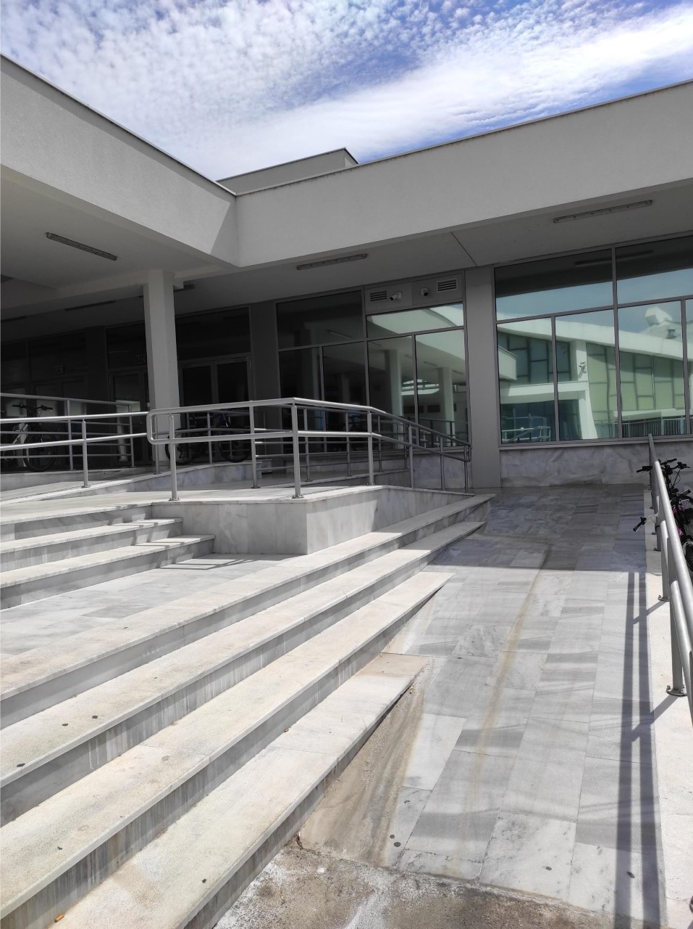
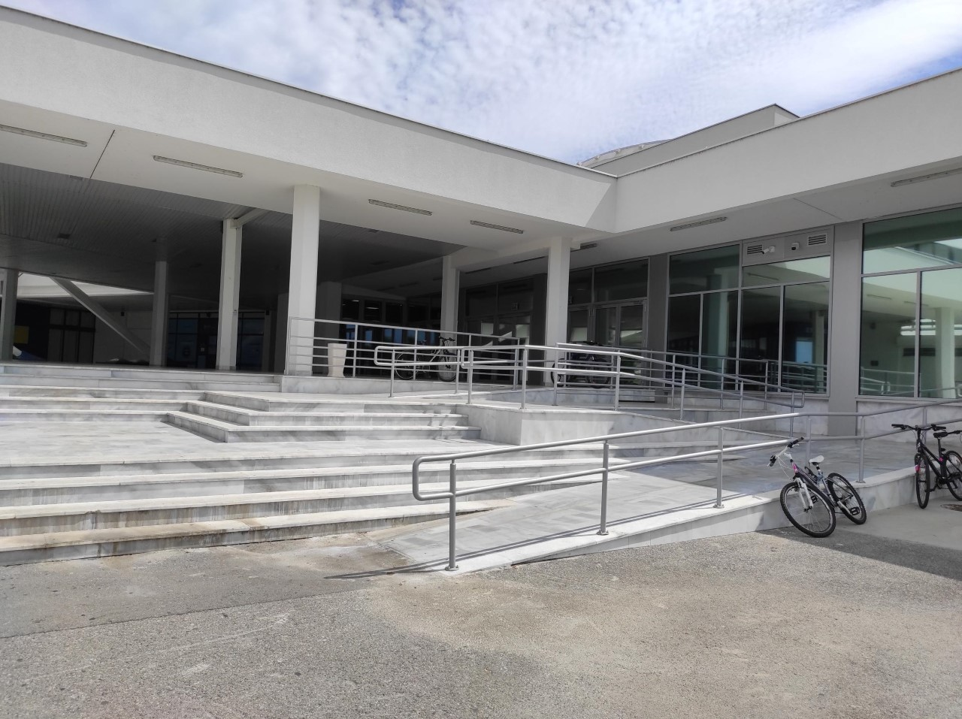
Sport and fun – sportski centar morača
The place look very accessiable, but it wasn’t possible to make an appointment for the interview. Anyways, we have heard from a lot of people that OSI group is very welcome in this place.

Slide 20
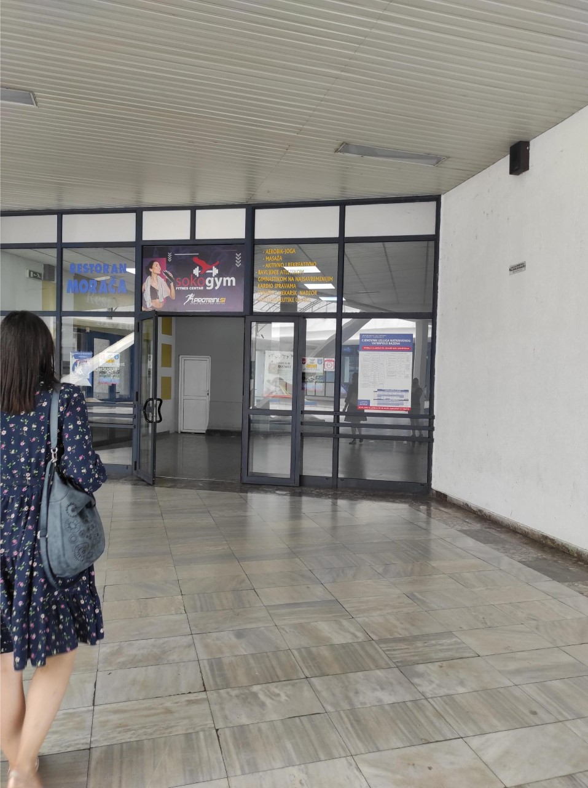
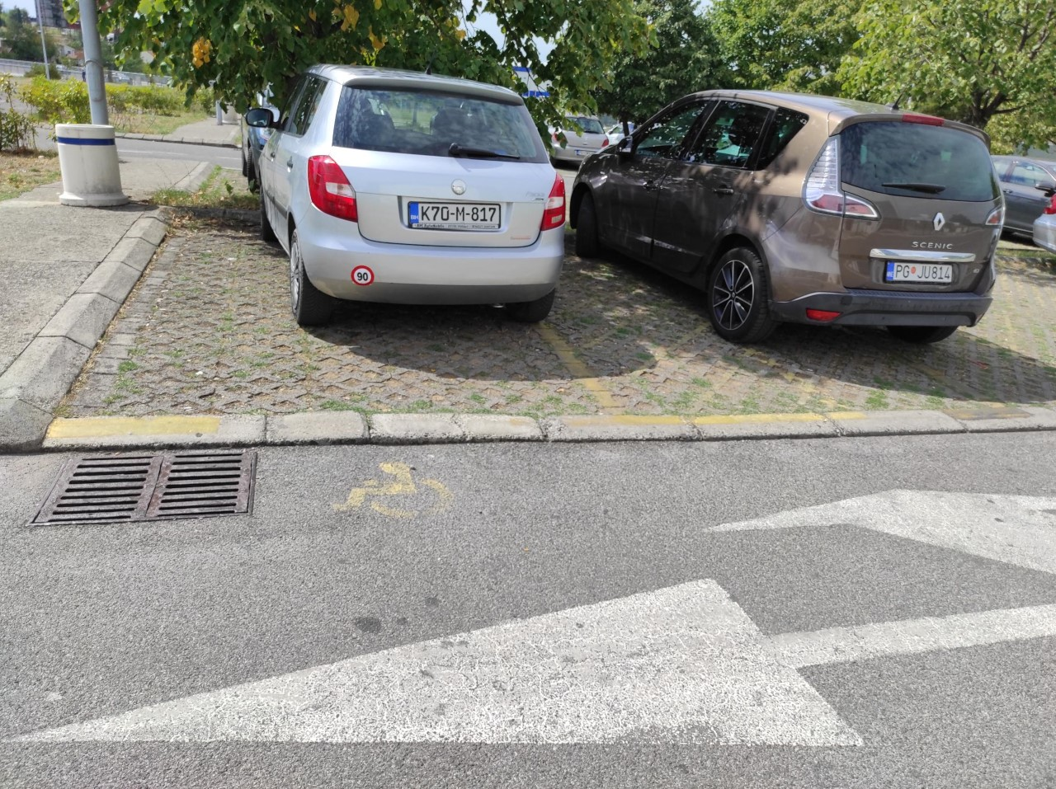

Slide 21
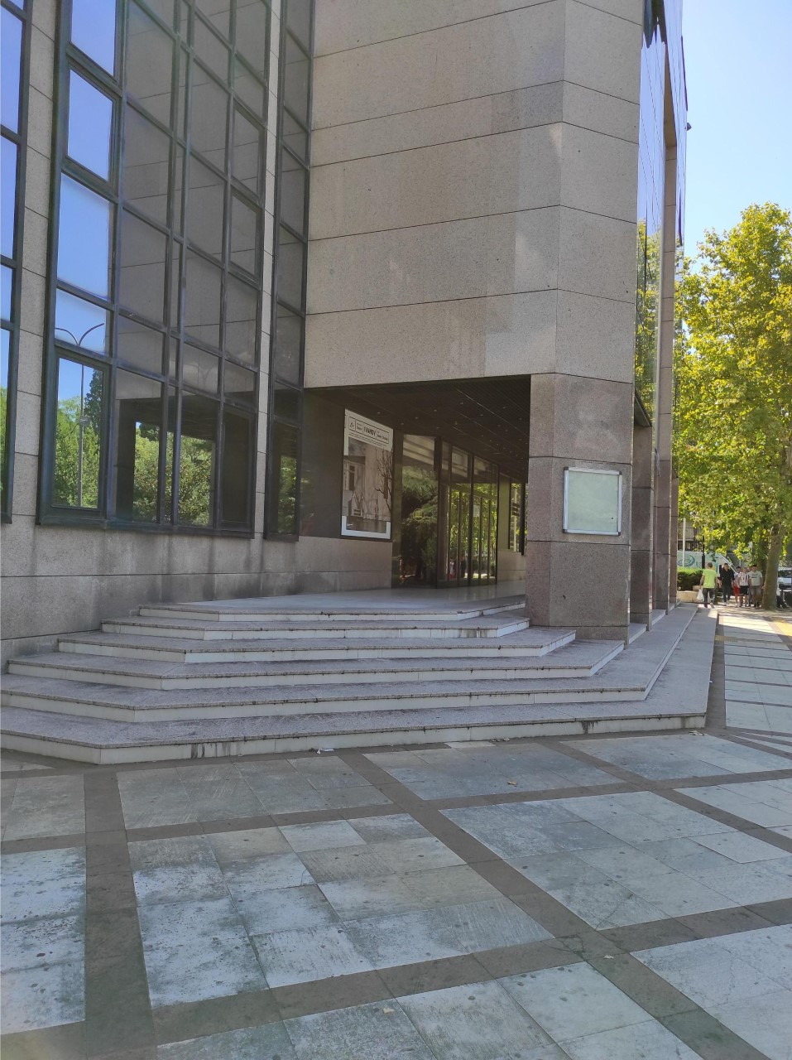
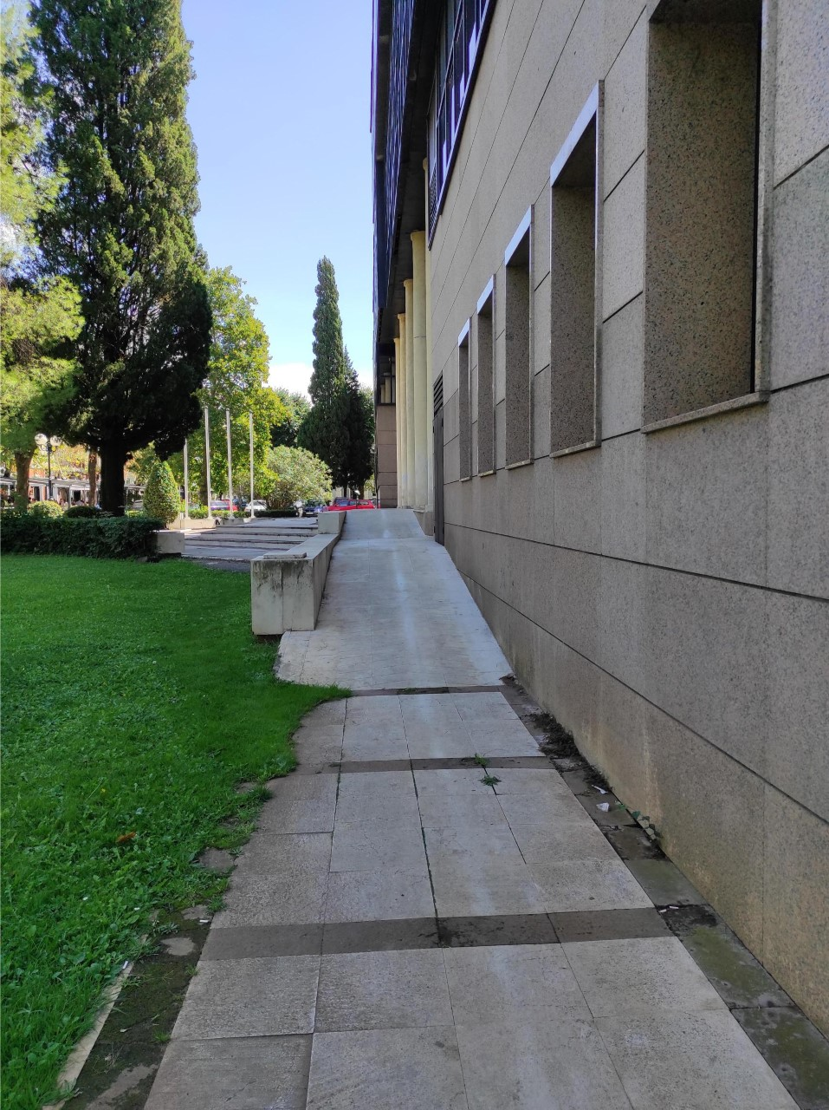
Montenegrin national theater
This institution has very specific relations with some of OSI organizatios. For those who wants to watch their favourites shows if they are part of an OSI organization admission is free.

Slide 22
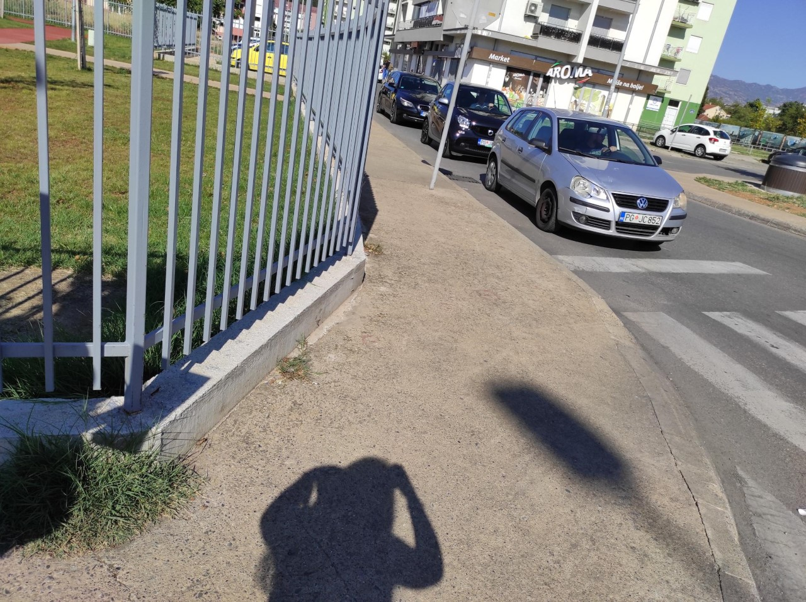
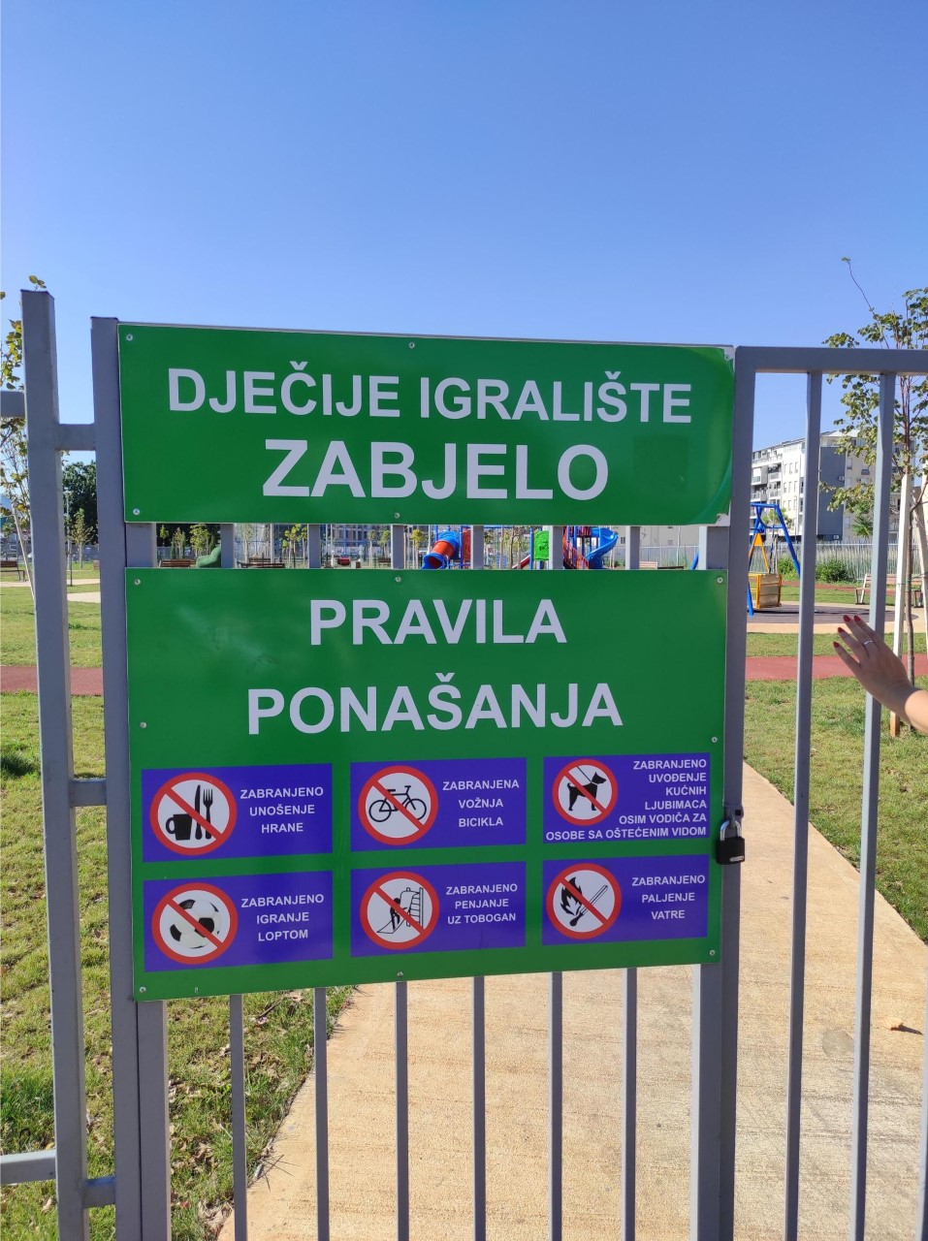
Playground for children and dogs ,,zabjelo’’
This is one of the newest children playgrounds in Podgorica, and it is fully inaccessible for people with disabilities. In the whole city, the place where children with disabilities could have fun – does not exist.

Slide 23
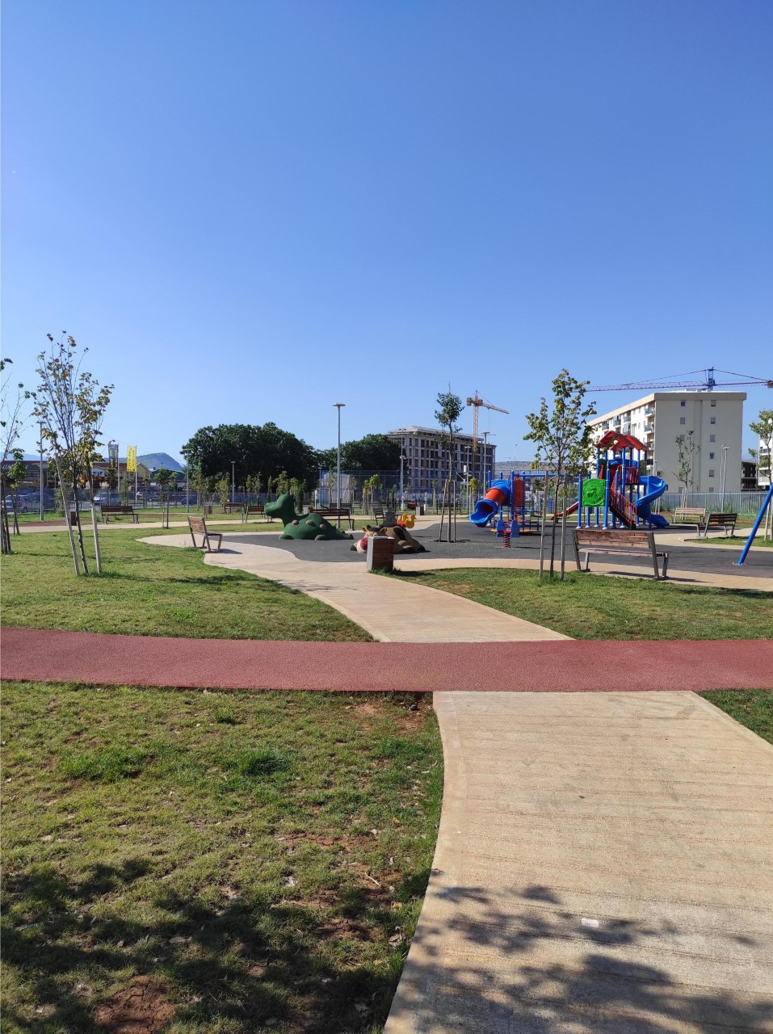
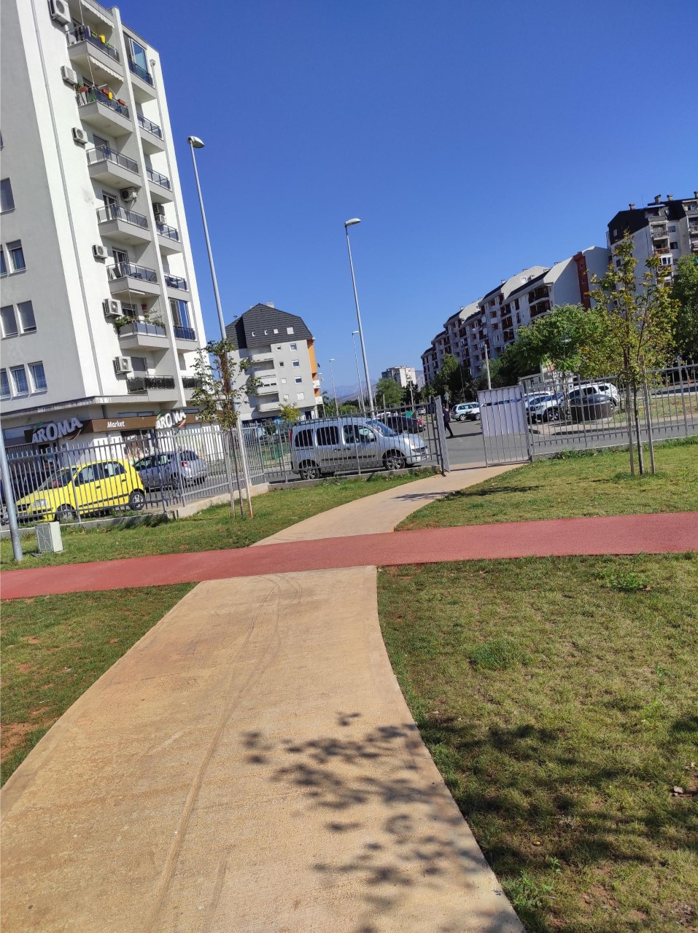
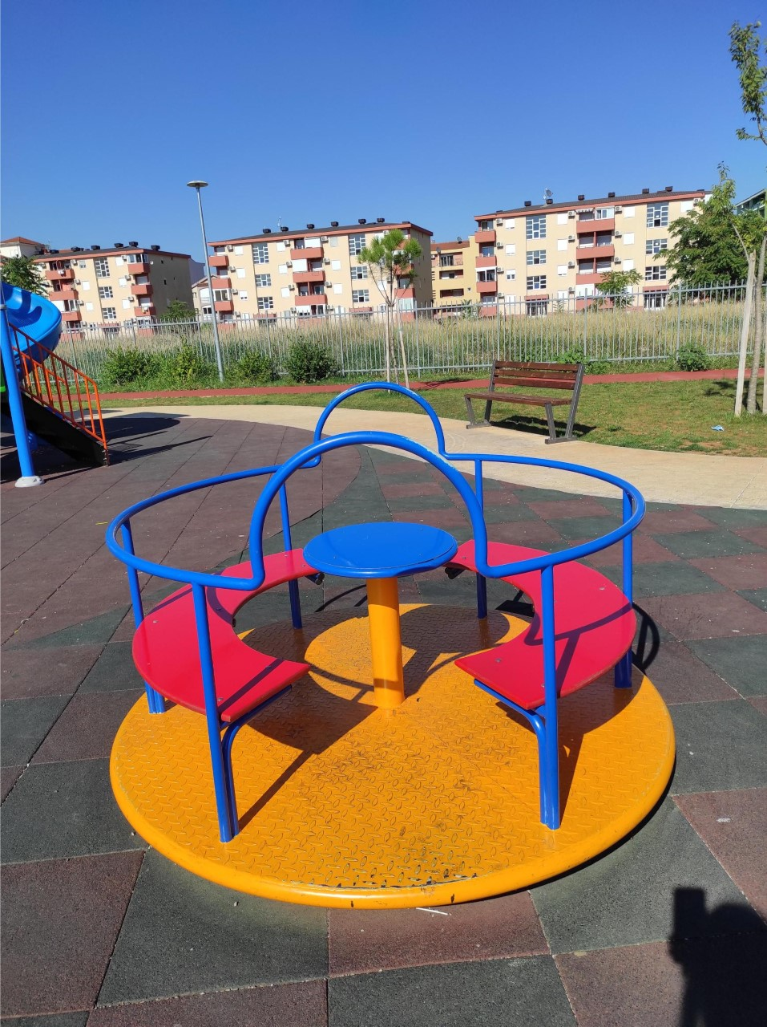

Slide 24
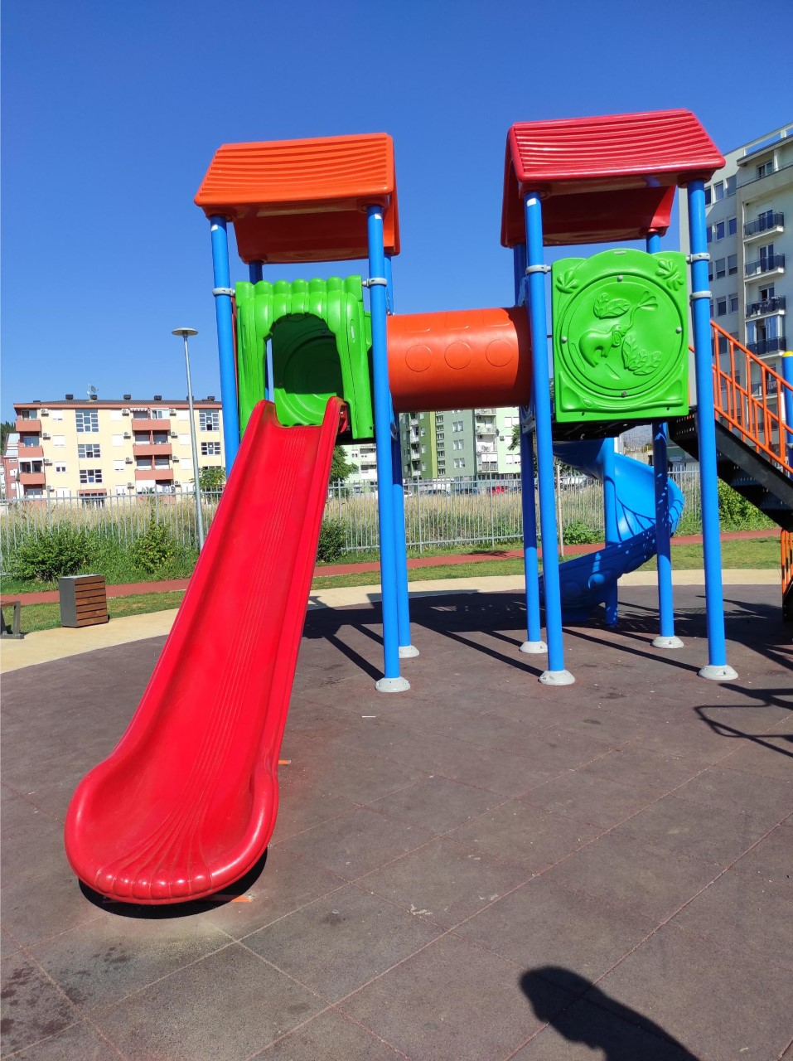
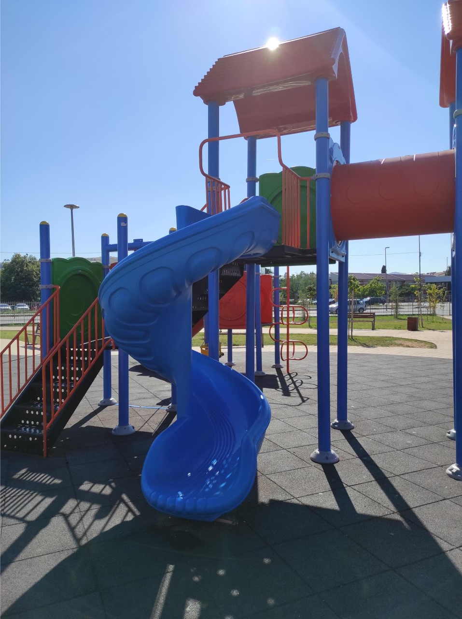

Slide 25
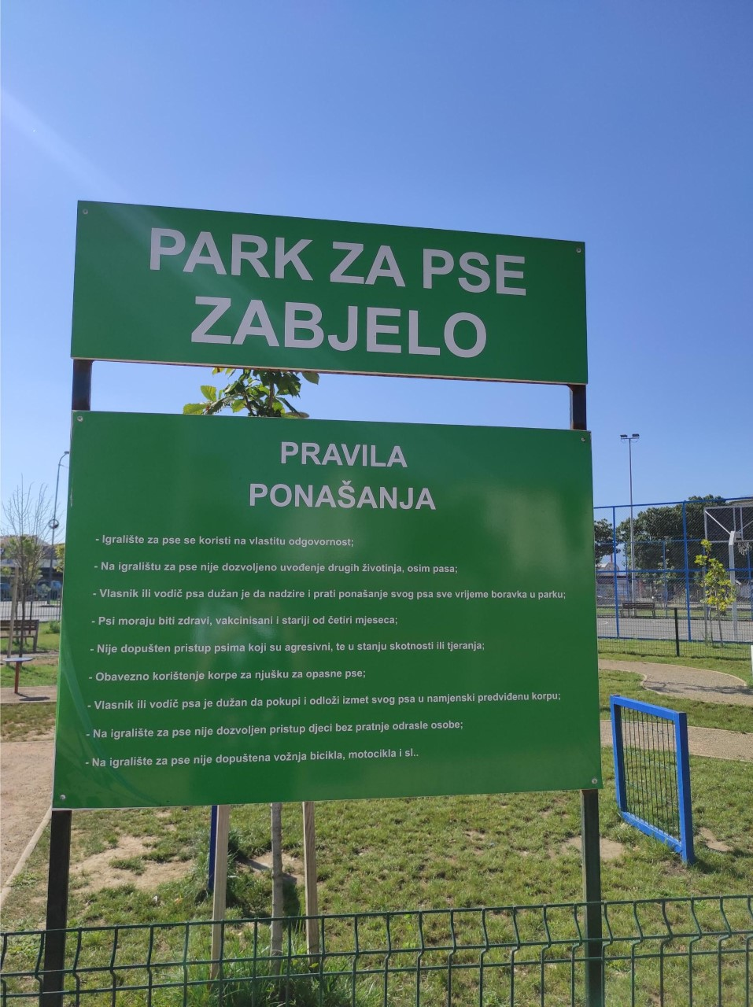
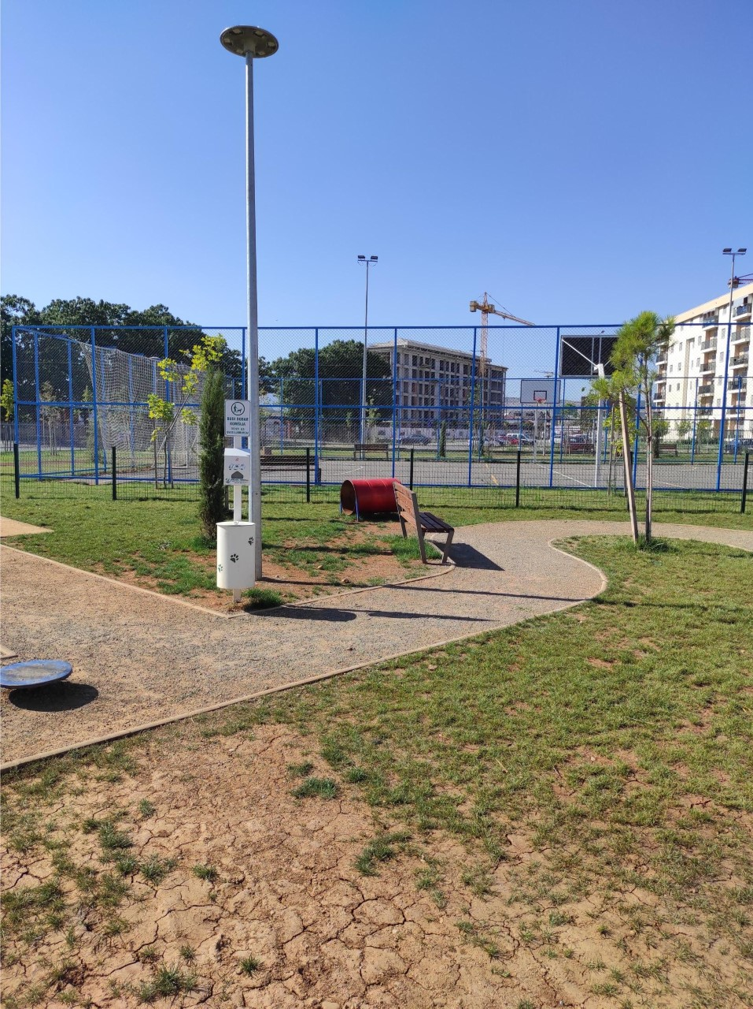
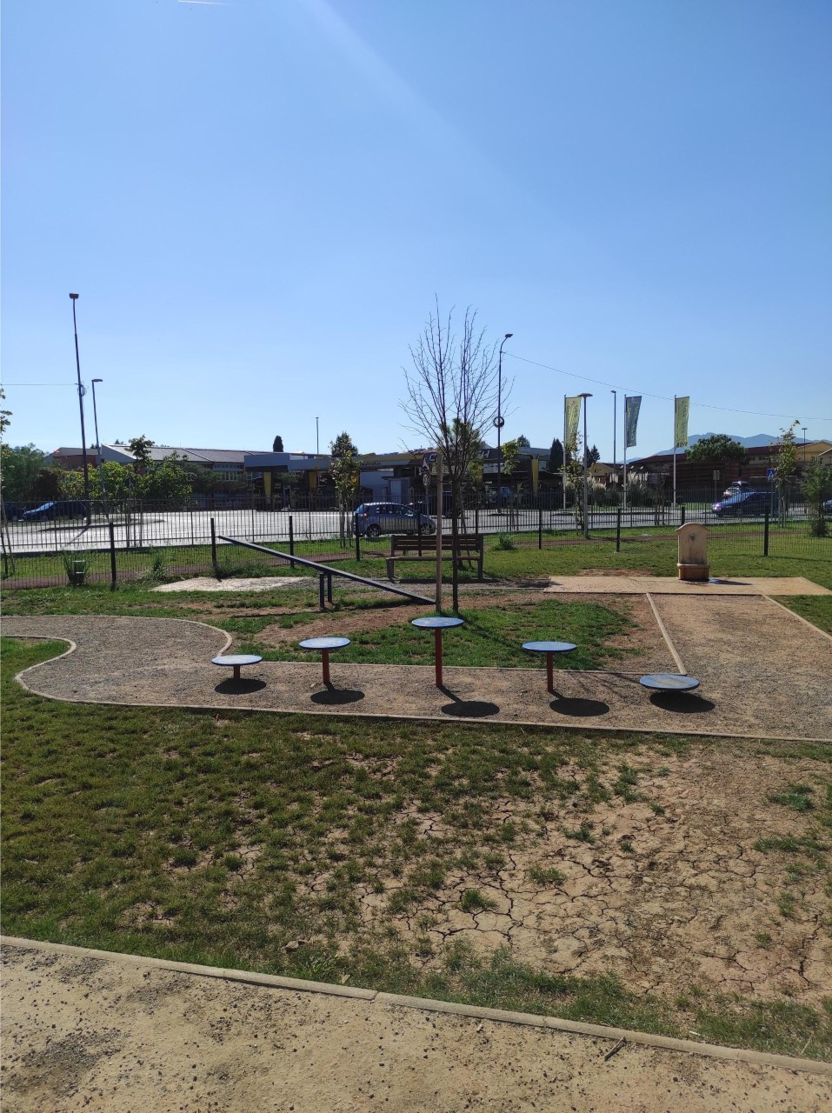

Slide 26
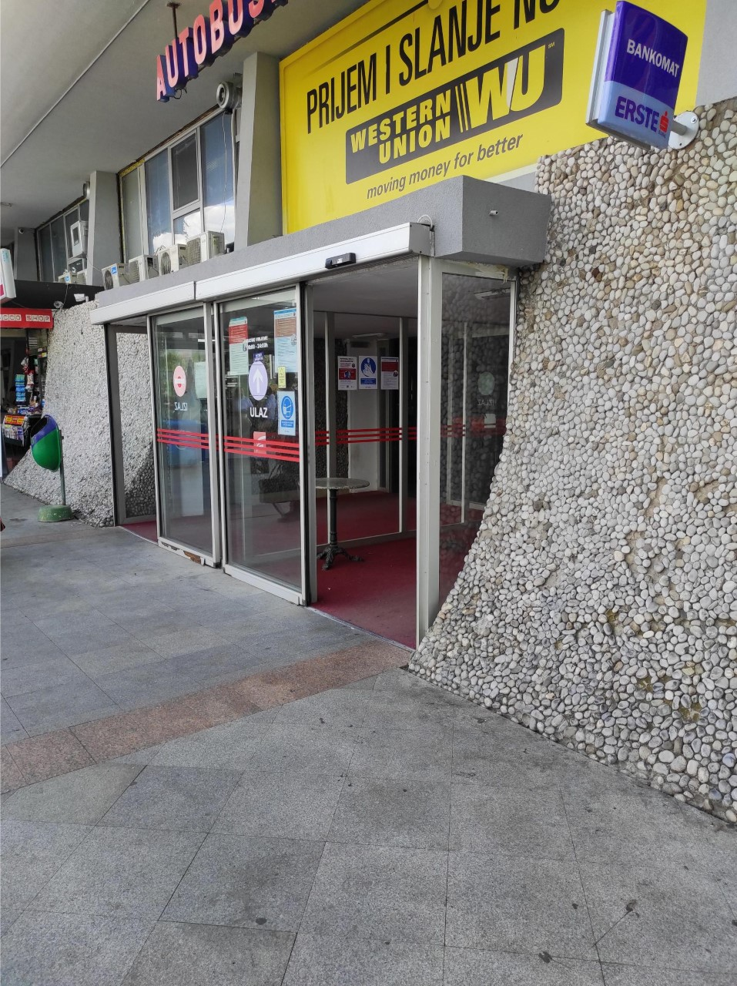
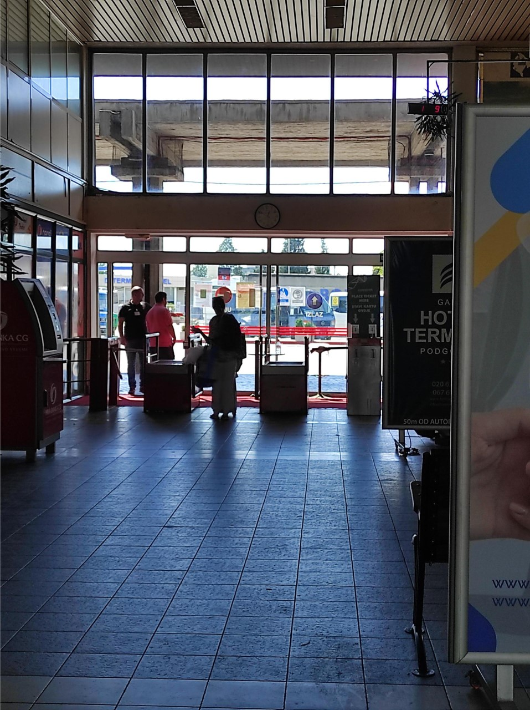
Public transportation bus station podgorica
Bus station in Podgorica is accessible for OSI, but the buses in general are not flexible at all.

Slide 27
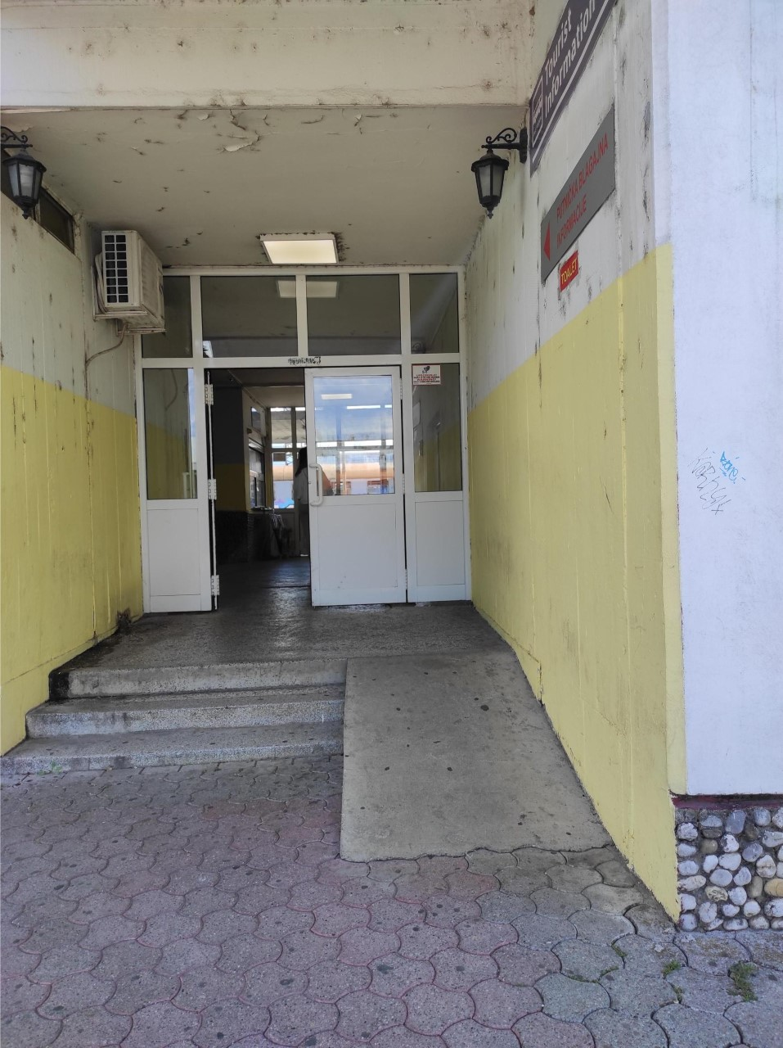
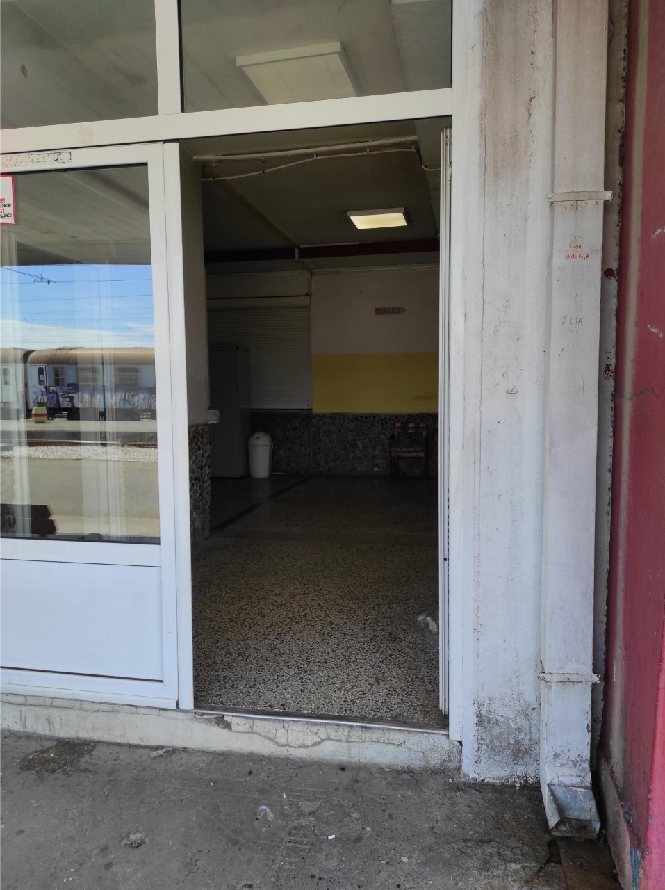
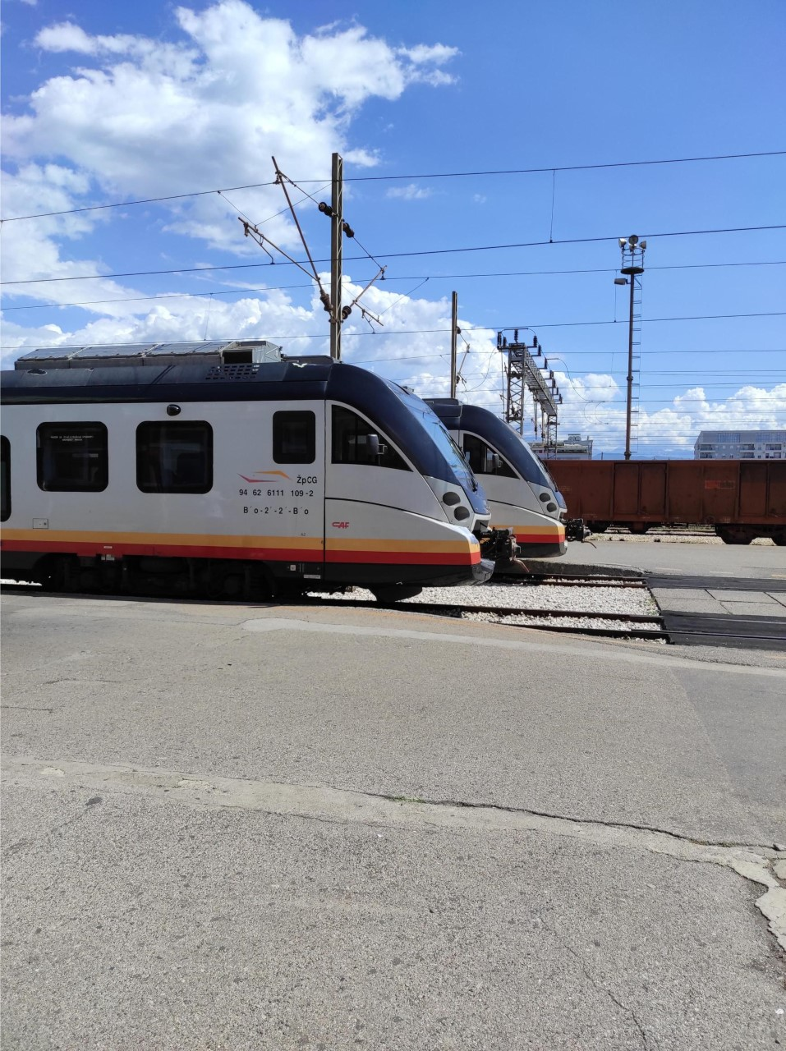
Train station podgorica

Slide 28


Public buses inside the podgorica
Three years ago, Germany gifted Montenegro several accassiable buses. The most of them are located in the capital city – Podgorica right now. Company ’’Bulatović DOO’’ uses them, but still not for every ride.

Slide 29
conclusions
People with disabilities are not included enough in the labour life and it seems like they have been discriminated in a lot of places and fields
Infrastructure in the most of Montenegrin towns is pretty bad and it needs more serious plans
The OSI group cannot fight alone for their rights
A huge number of people hired in public institutions do not know how to behave when they communicate with OSI

Slide 30
Thank you for your attention!

